Slide 1
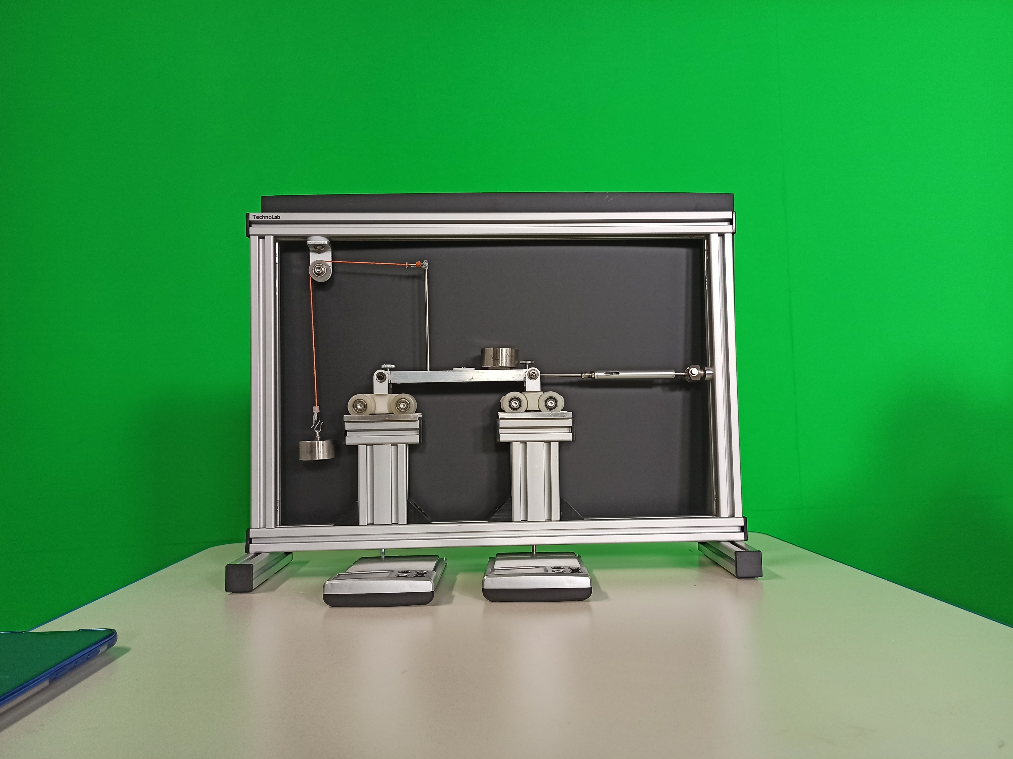
Reactions of a Simply Supported Bar
from a Variety of Applied Loads
Experiment by STRUCOMP P/L
Load Case#02
Offset Horizontal Load through
Location (1) + Vertical Load at Selected Locations

Slide 2
Experimental Identification
Simply Supported Bar

Slide 3
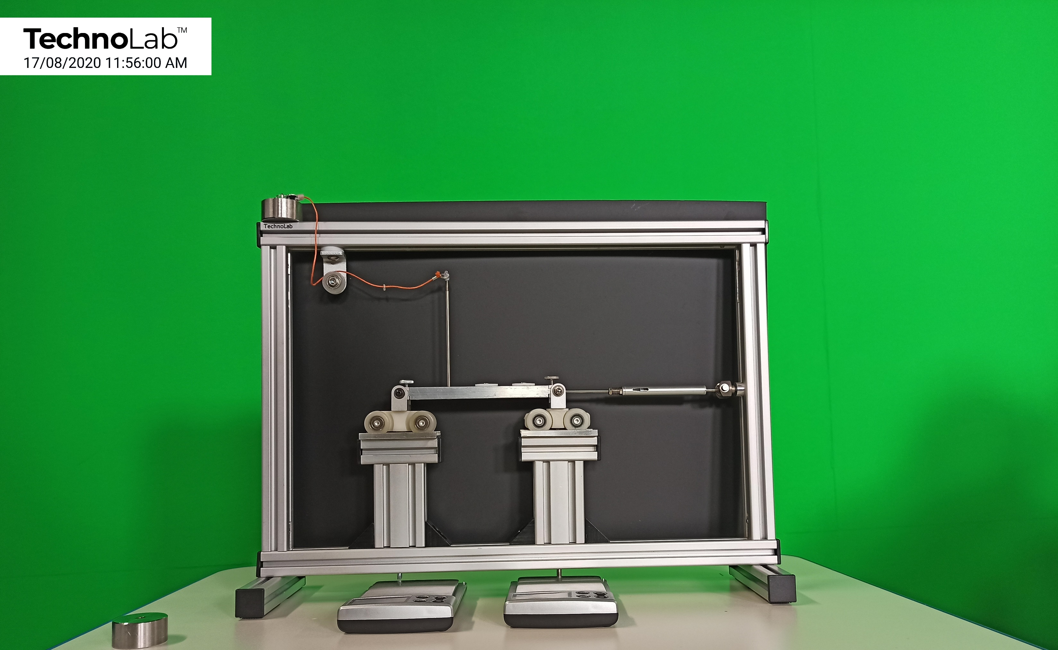
Reactions
of the Bar
in its
Un-loaded
State
C
H_{C}
A
B
V_{A}
V_{B}
Simply Supported Bar

Slide 4
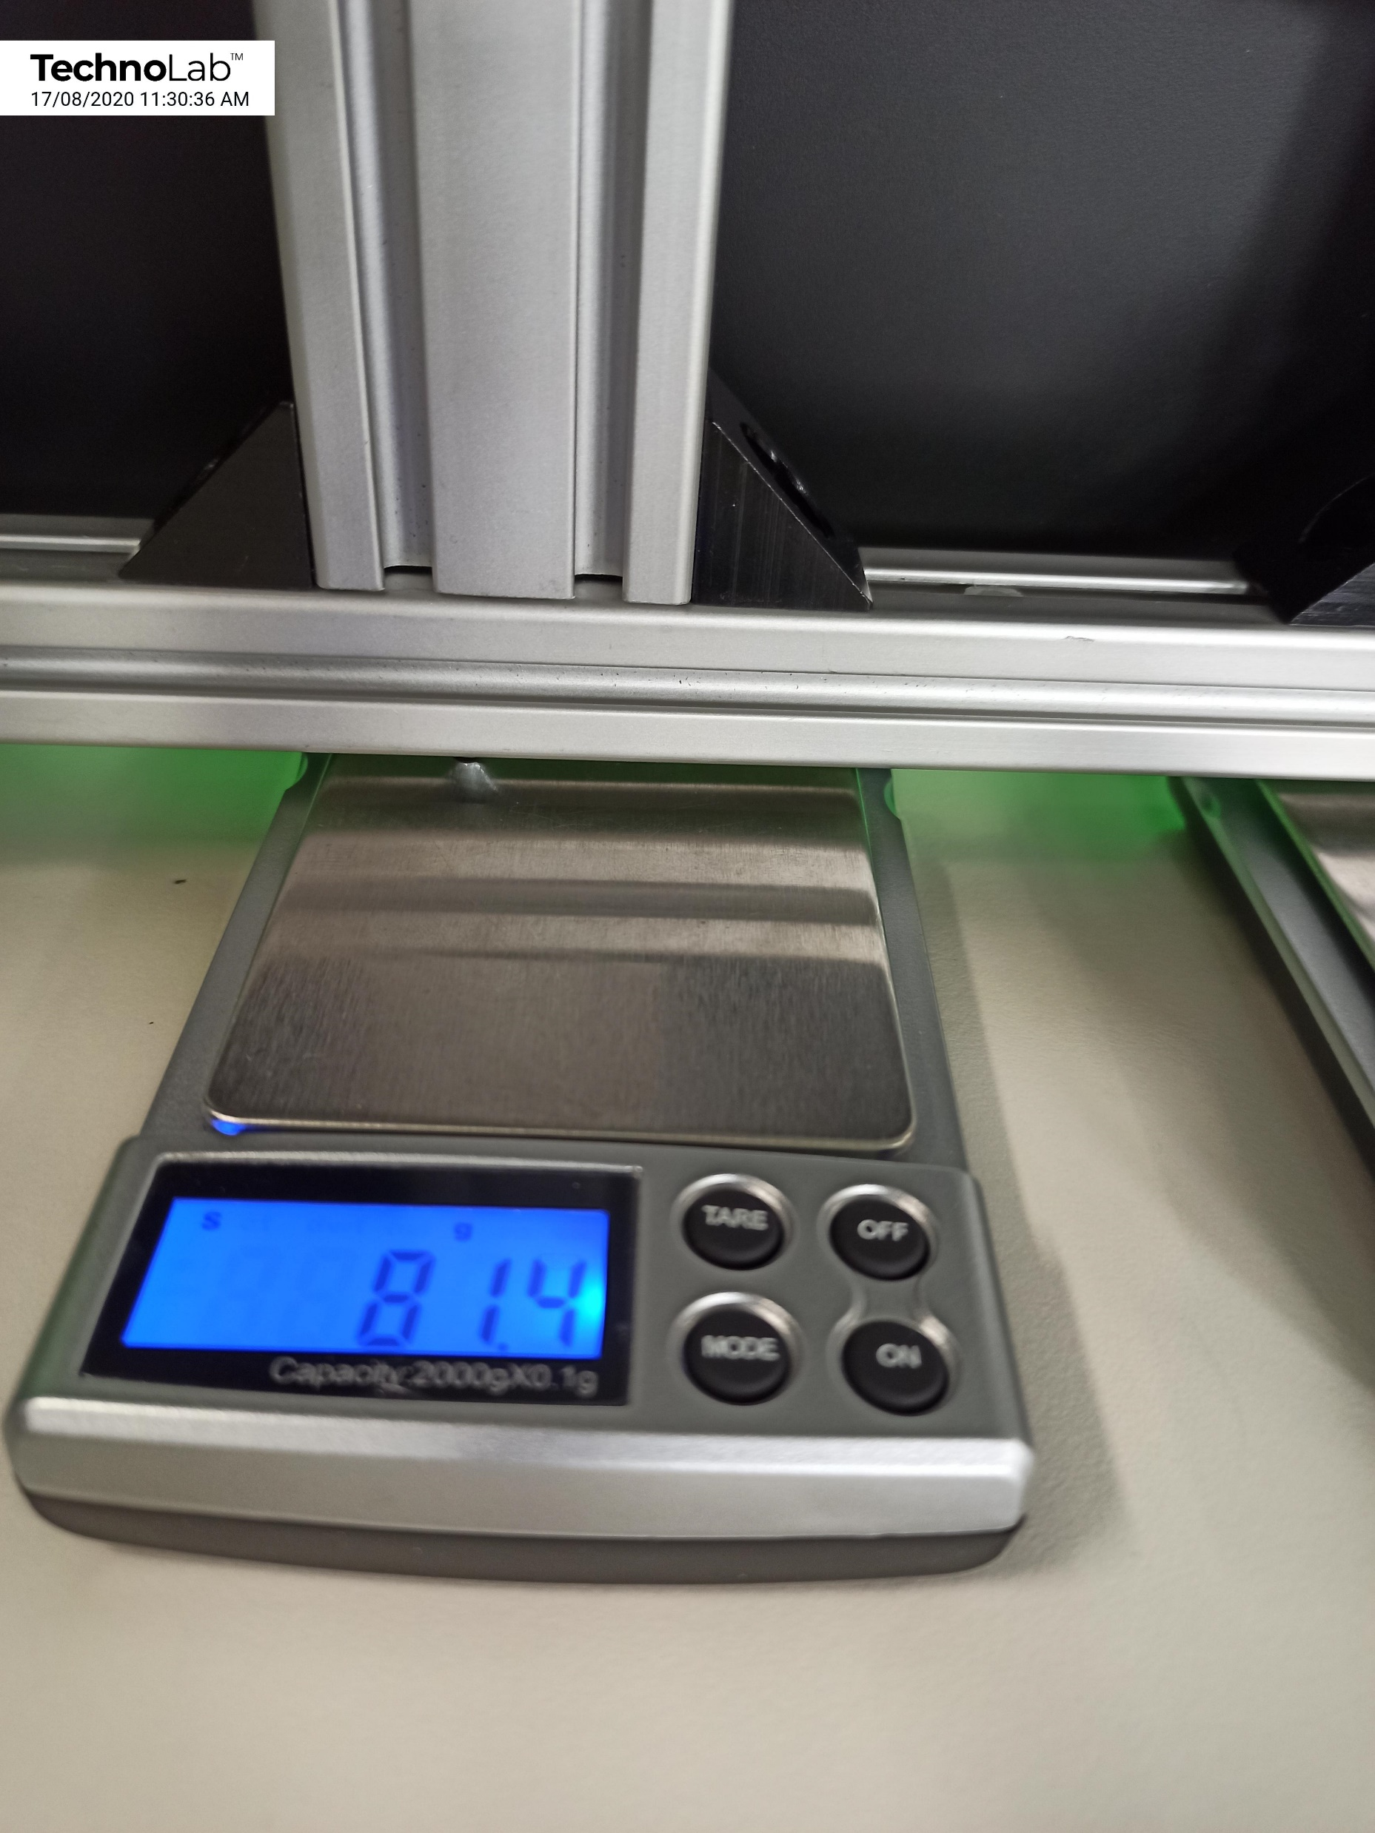
LHS
(free-roller)
Reaction
of the
Bar.
81.4 g
Simply Supported Bar

Slide 5
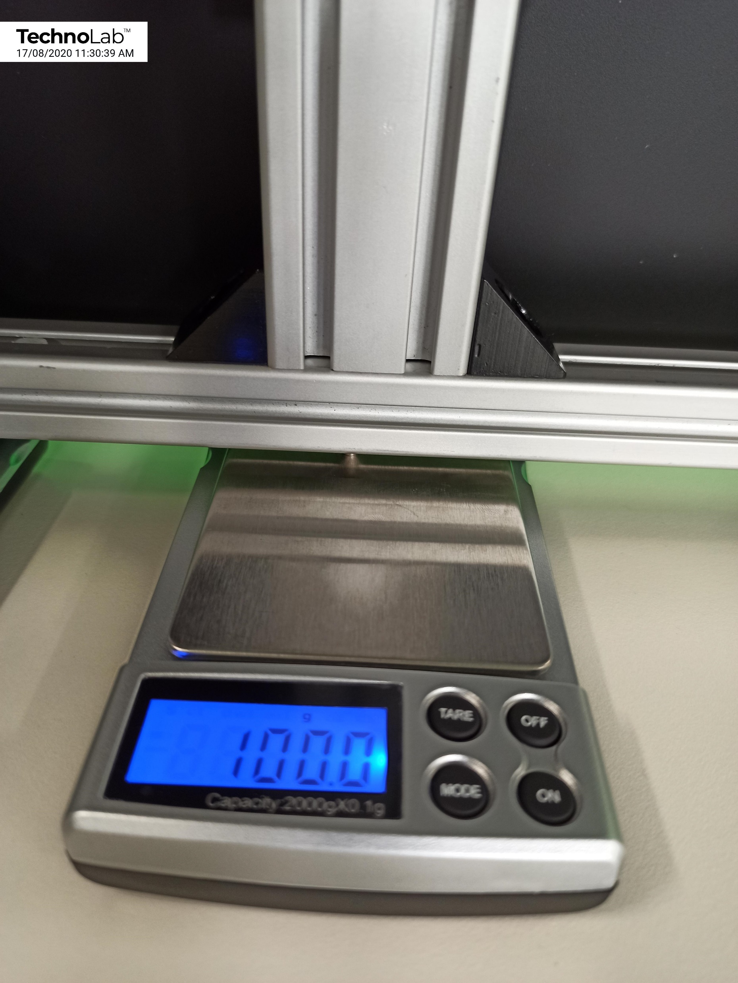
RHS
(propped-roller)
Reaction
of the
Bar.
100.0 g
Simply Supported Bar

Slide 6
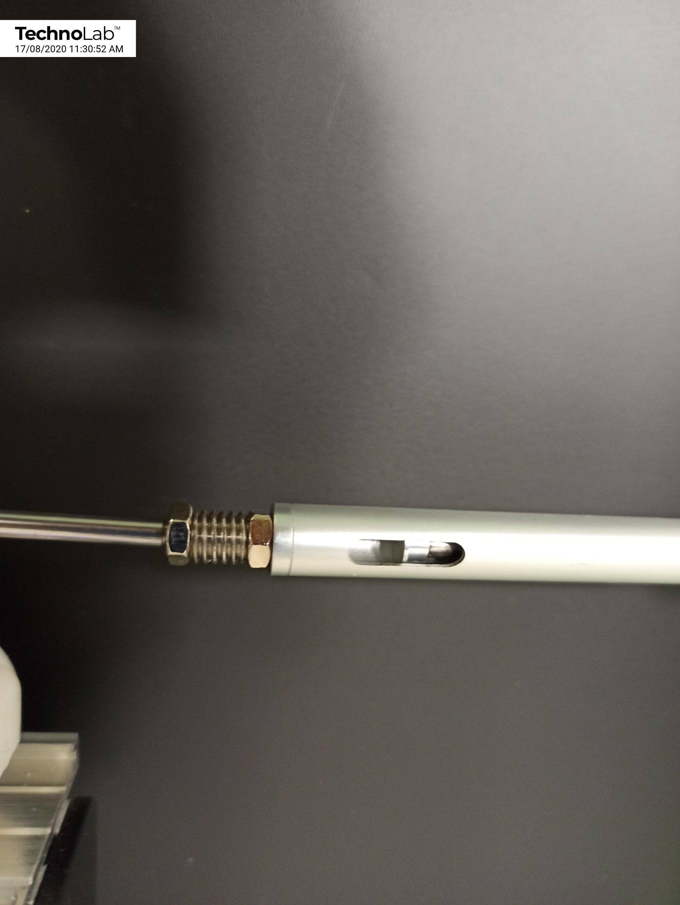
Prop Restraint:
Slot: Gap to Length Ratio
b = 66.5
b
L = 137.5
b
L
= 0.484
L
Simply Supported Bar

Slide 7
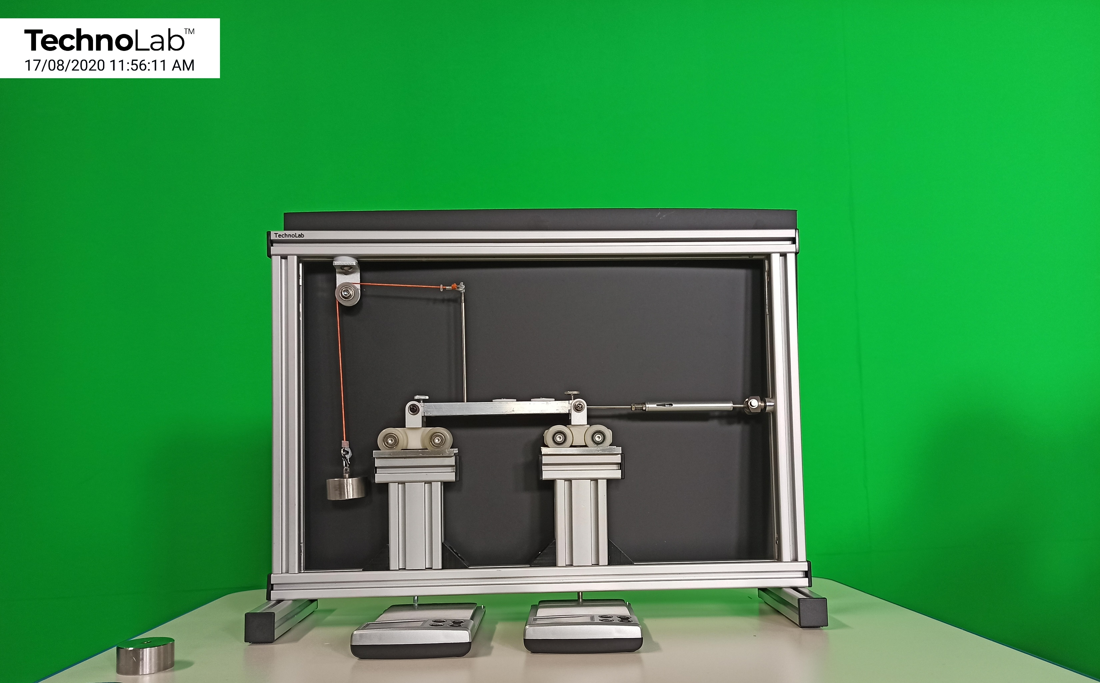
Reactions
of the Bar
in its
Horizontal Loaded
State
Ph
C
H_{C}
A
B
V_{A}
V_{B}
Simply Supported Bar

Slide 8
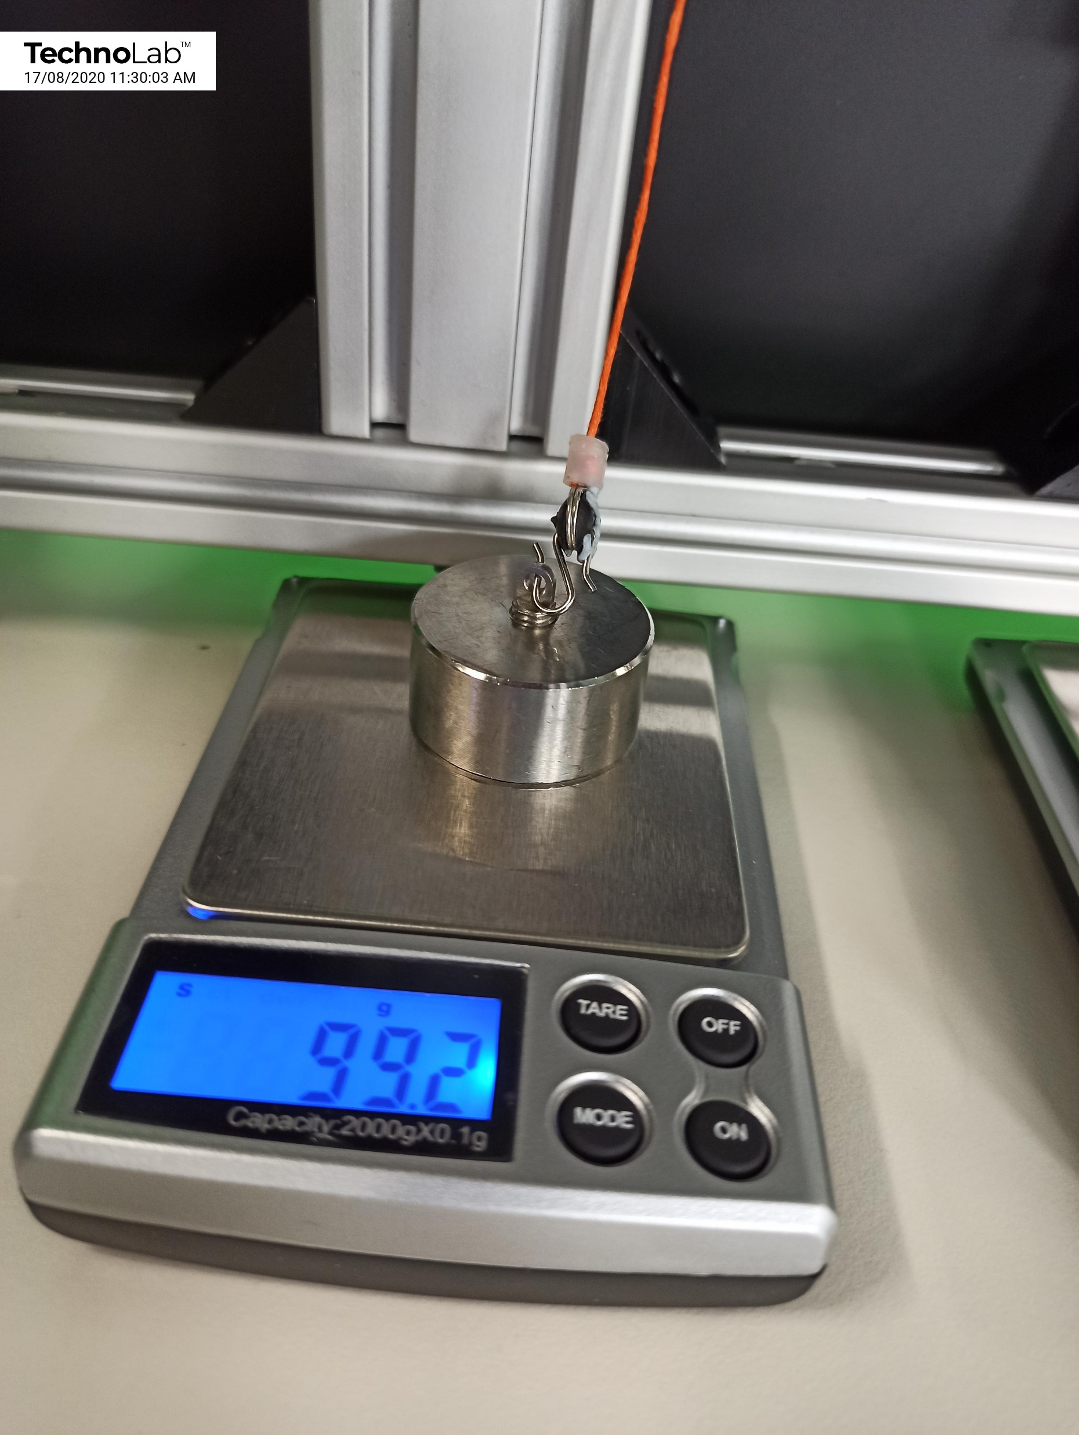
Applied
Load
Ph
99.2 g
Simply Supported Bar

Slide 9
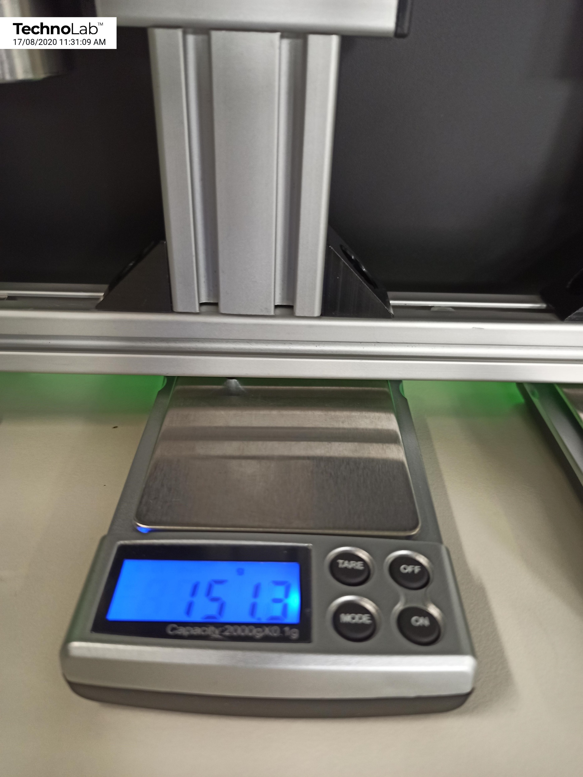
LHS
(free-roller)
Reaction
of the
Bar.
151.3 g
Simply Supported Bar

Slide 10
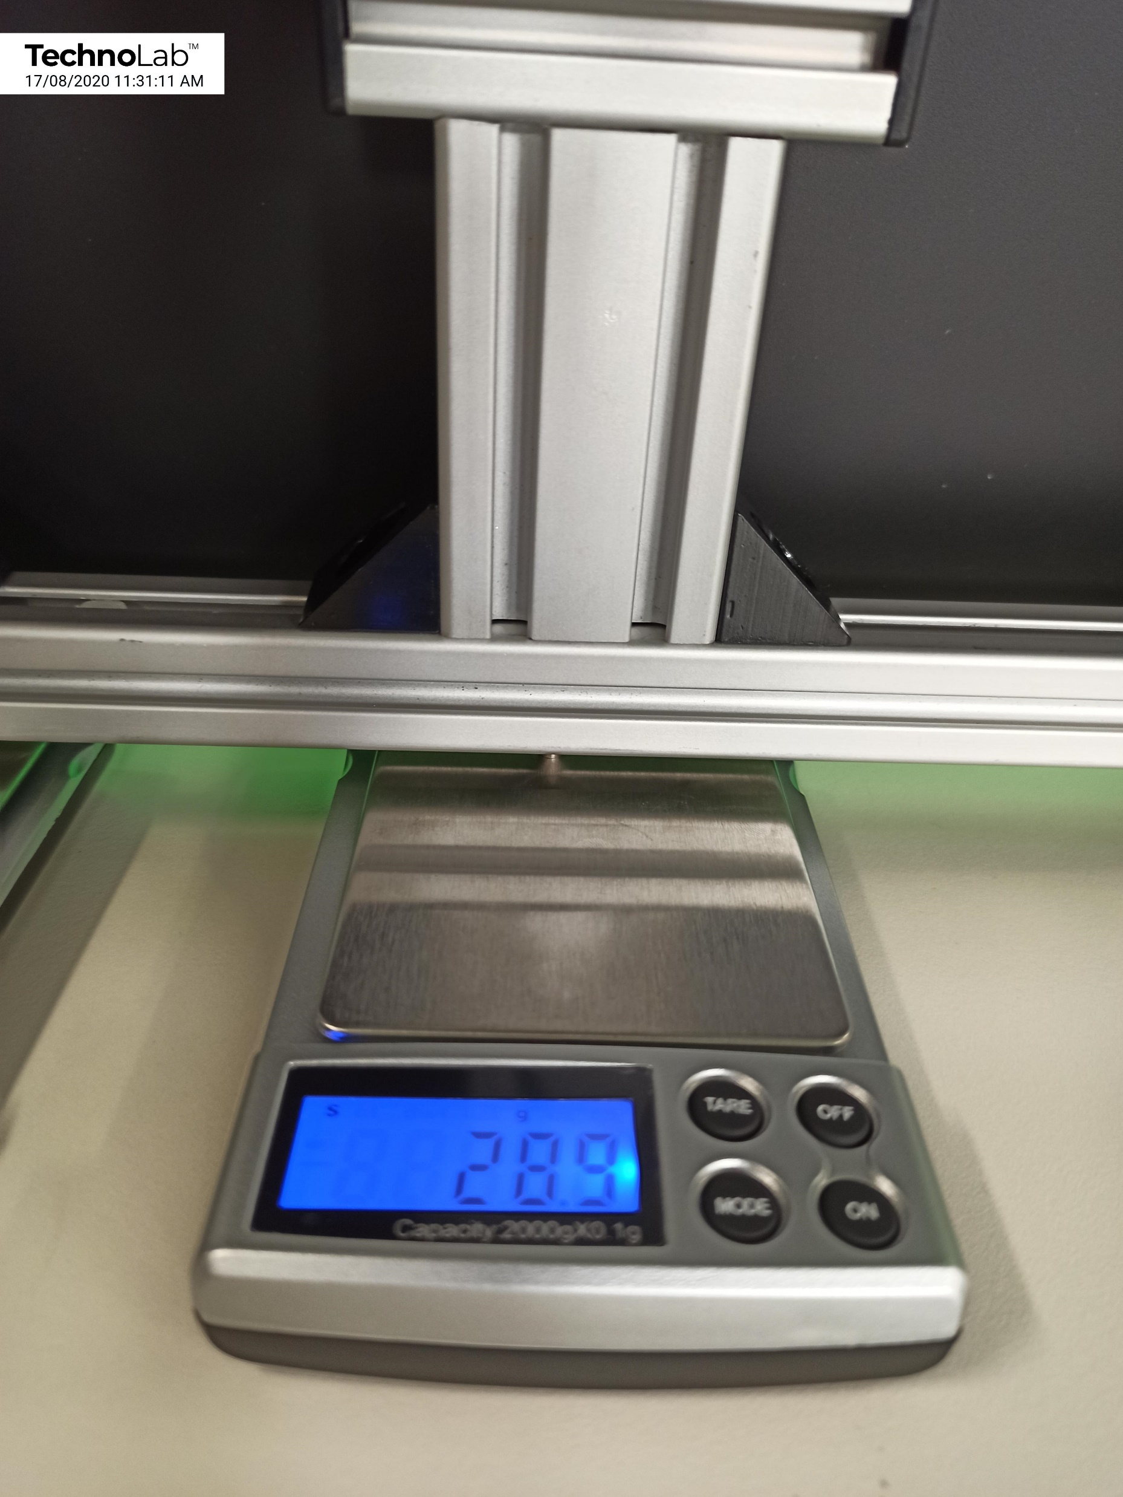
RHS
(propped-roller)
Reaction
of the
Bar.
28.9 g
Simply Supported Bar

Slide 11
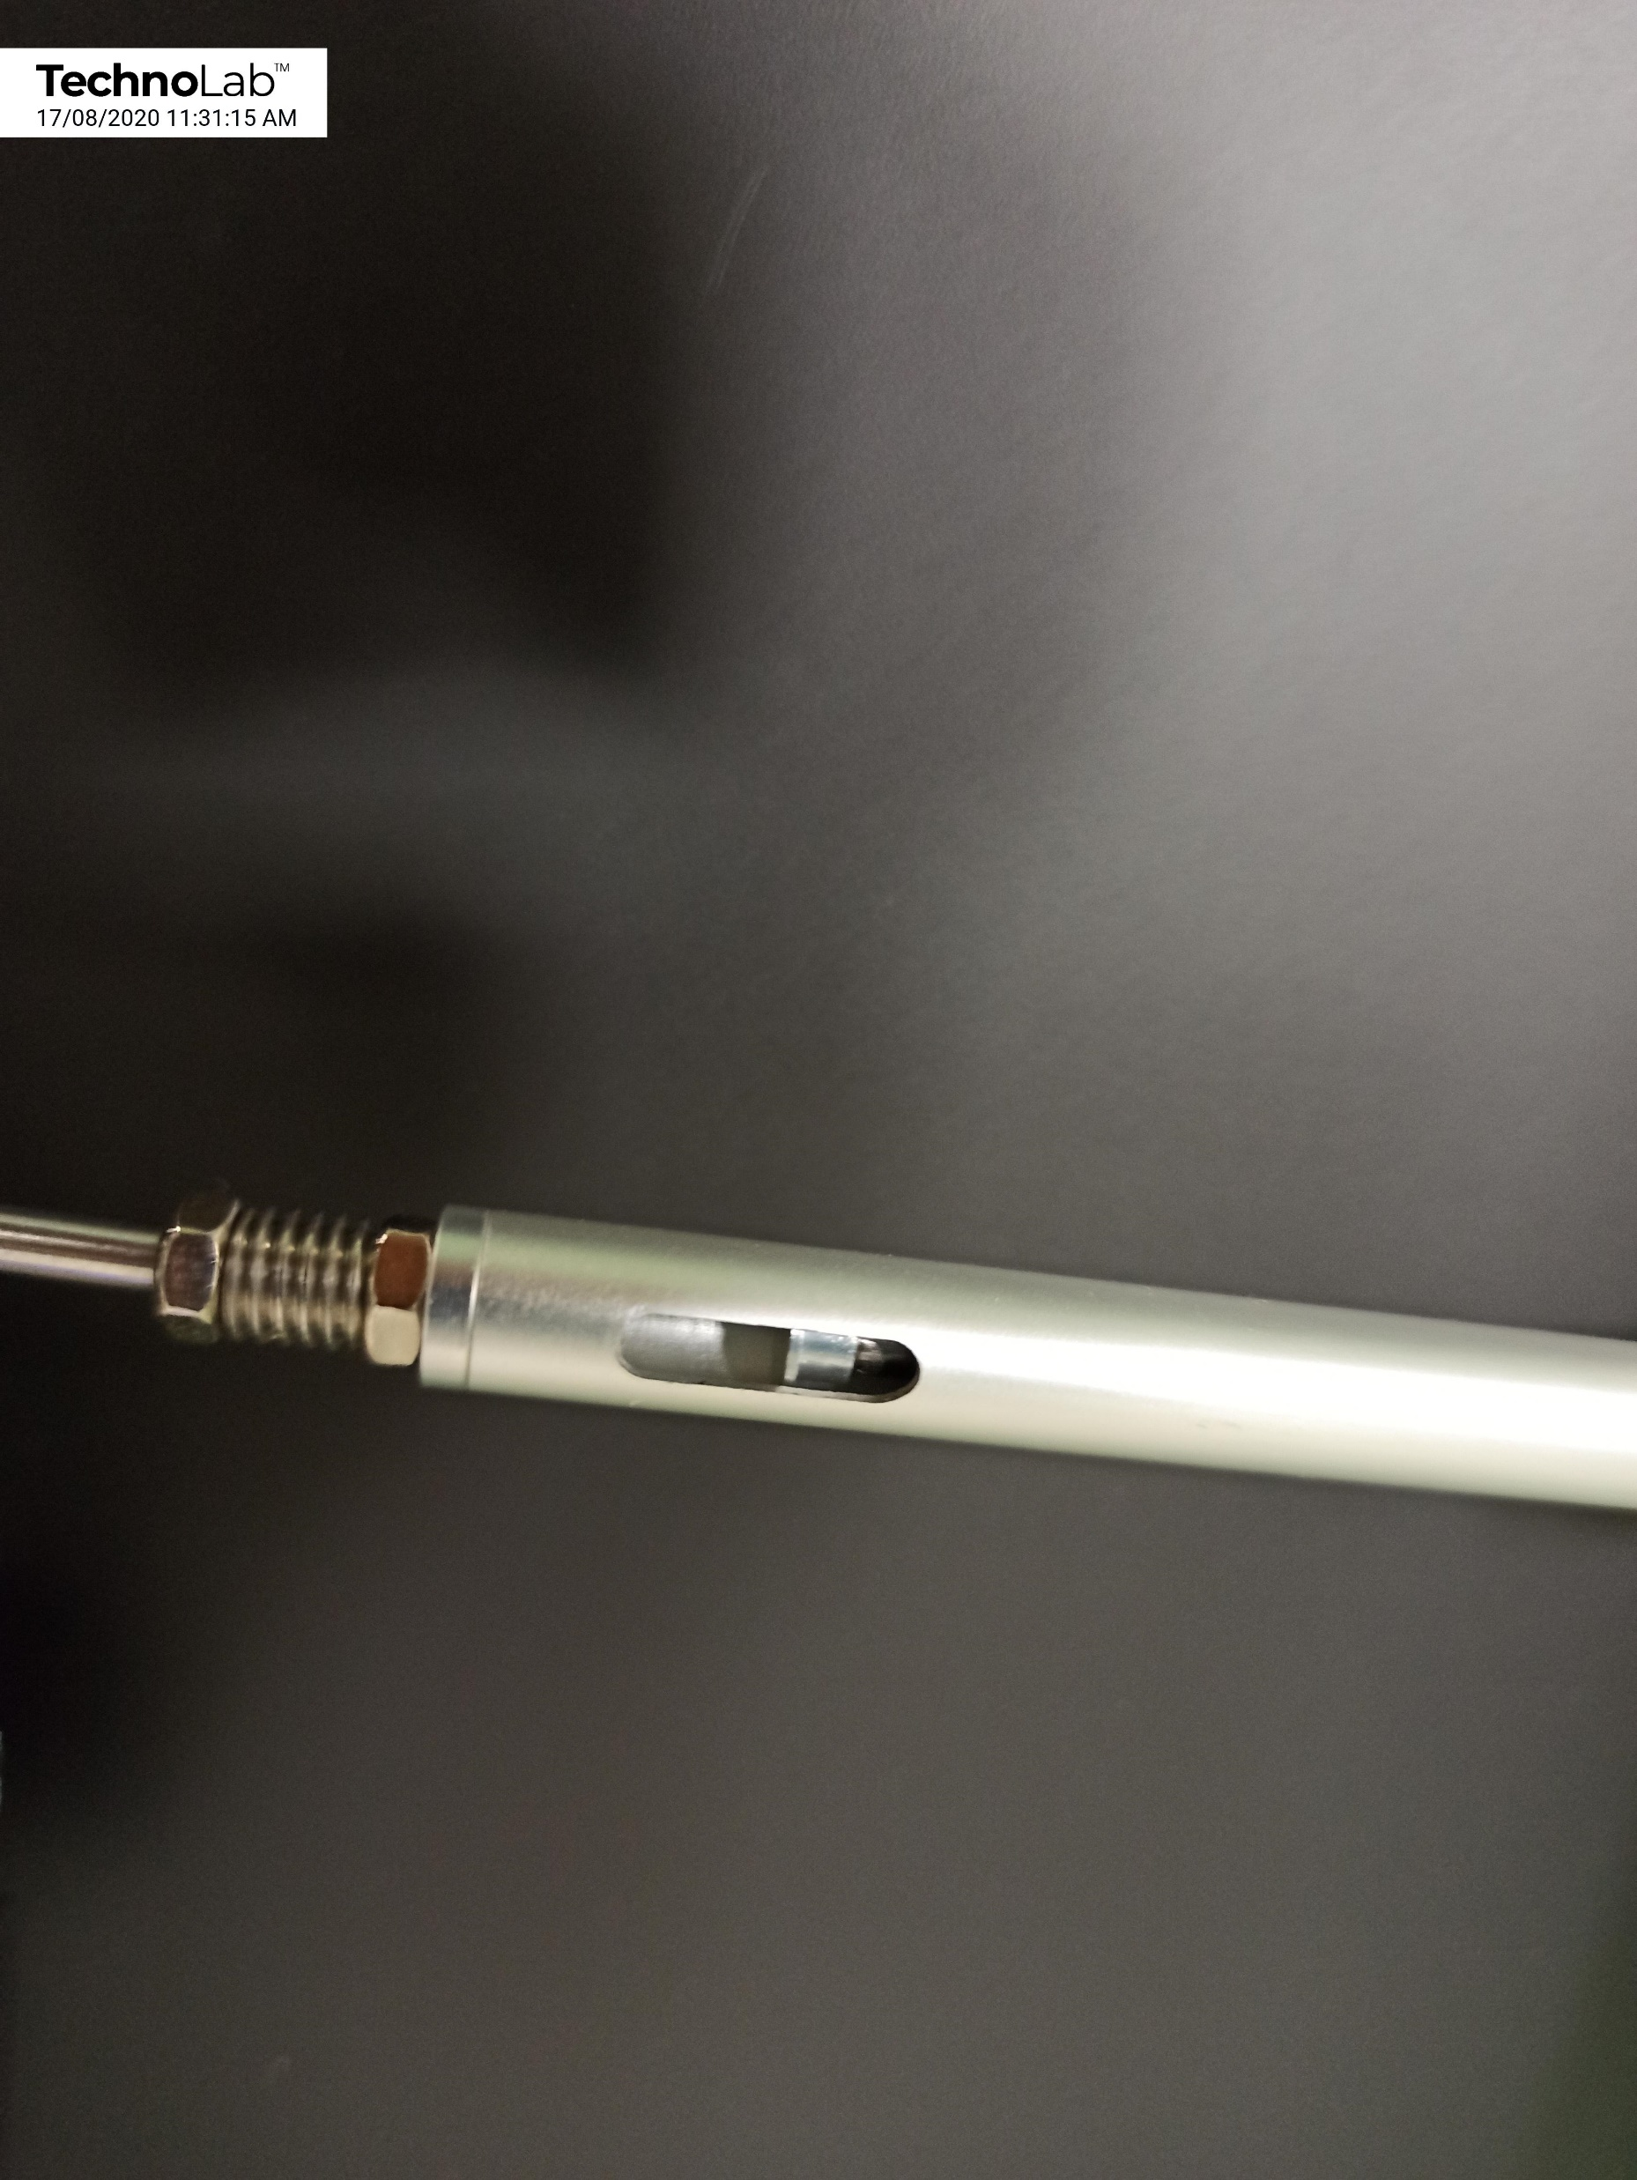
Prop Restraint:
Slot: Gap to Length Ratio
b = 77
b
L = 137
L
b
= 0.562
L
Simply Supported Bar

Slide 12
Experimental Results (V_{A} & V_{B}):
Reactions | V_{A} - LHS (gram) | V_{B} - RHS (gram)
Horizontal Load + Self-weight | 151.3 | 28.9
Self-Weight | 81.4 | 100.0
Applied Load (alone) | 69.9 | -71.1
Load (alone) | V_{A} =0.69 N | V_{B} = -0.70 N
Simply Supported Bar

Slide 13
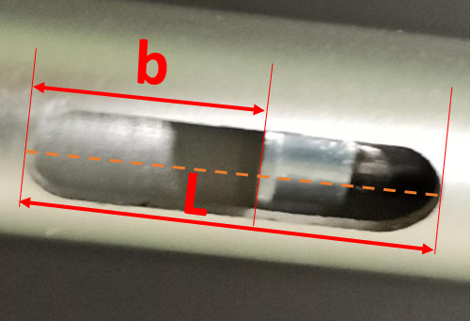
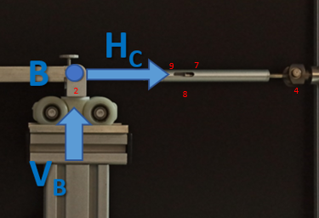
Experimental Results (H_{C}):
Prop Member Force (H_{C})
= Spring Stiffness (k_{s}) x Elongation
Elongation of Prop
= (Gap Length₁ – Gap Length₀)
Gap Length = True Slot Length (13.0 mm)
x Measured Gap/Slot_Length Ratio $\left(b/L\right)$
Prop Member Force (H_{C}) = k_{s} x 13.0 (${\left(b/L\right)}_{1}$ - ${\left(b/L\right)}_{0}$)
$${\left(b/L\right)}_{1}$$ | $${\left(b/L\right)}_{0}$$ | ${\left(b/L\right)}_{1}$ - ${\left(b/L\right)}_{0}$ | Force: H_{C} k_{s} x 13.0 (${\left(b/L\right)}_{1}$ - ${\left(b/L\right)}_{0}$)
0.484 | 0.562 | 0.078 | 1.02 N
$$k_{s}=$$
$$1.0N/mm$$
Simply Supported Bar

Slide 14
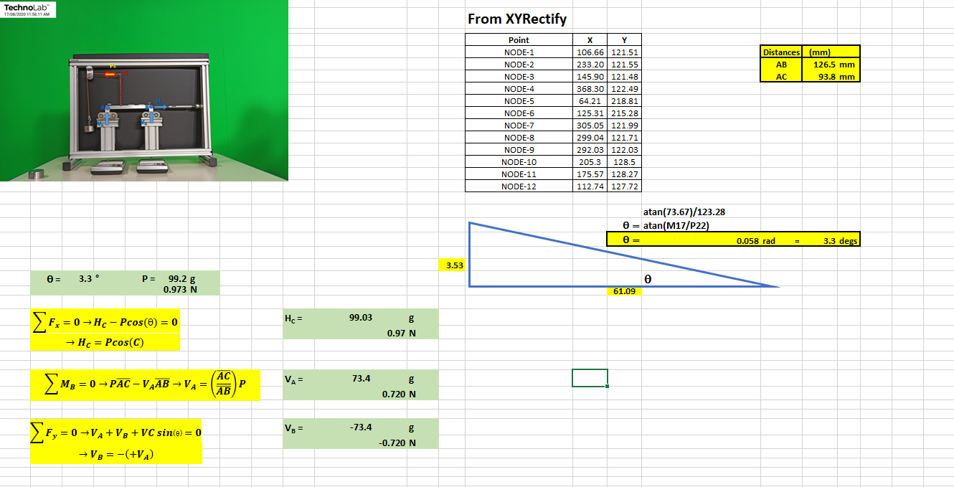
Theoretical Results (H_{C}, V_{A} & V_{B}):
From Spreadsheet
Simply Supported Bar

Slide 15
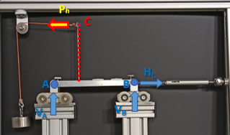
Theoretical Results (H_{C}, V_{A} & V_{B}):
“Good” Agreement
Approach | H_{C} (N) | V_{A} (N) | V_{B} (N)
Experimental | 1.02 | 0.70 | -0.69
Theoretical | 0.98 | 0.73 | -0.73
Simply Supported Bar

Slide 16
Skipping 1st & 2nd Vertically Applied Load Cases

Slide 17
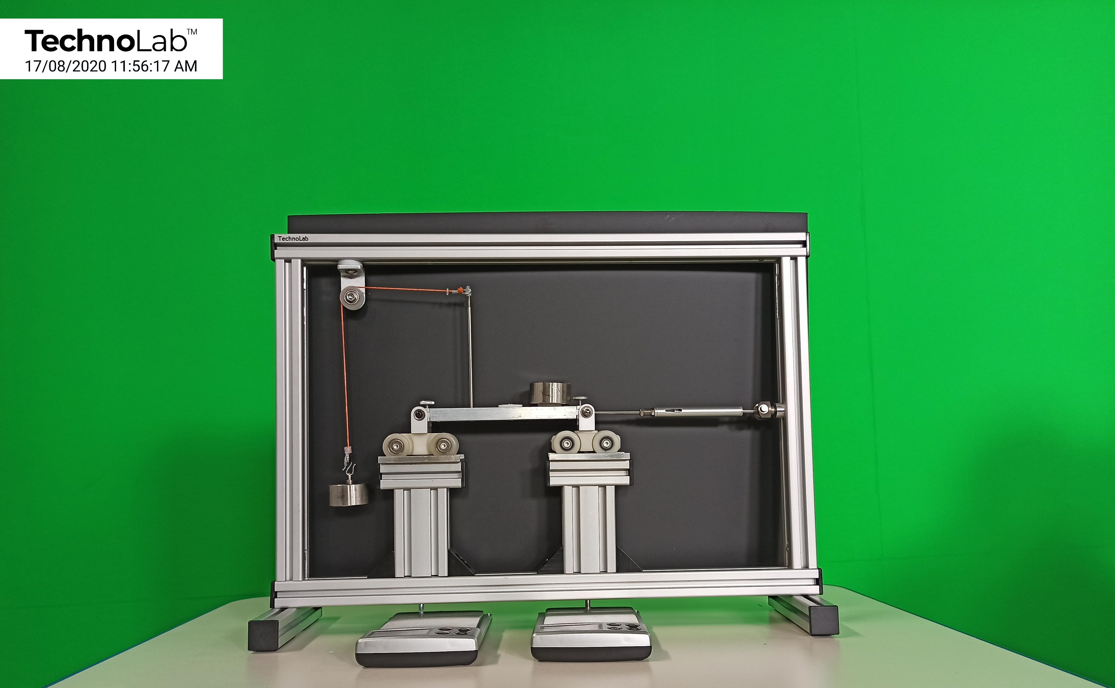
Reactions
of the Bar
in its
Horizontal and
3rd Vertical
Loaded State.
Ph
C
Pv
H_{C}
A
B
V_{A}
V_{B}
Simply Supported Bar

Slide 18
Applied
Load
Ph
99.2 g
Simply Supported Bar

Slide 19
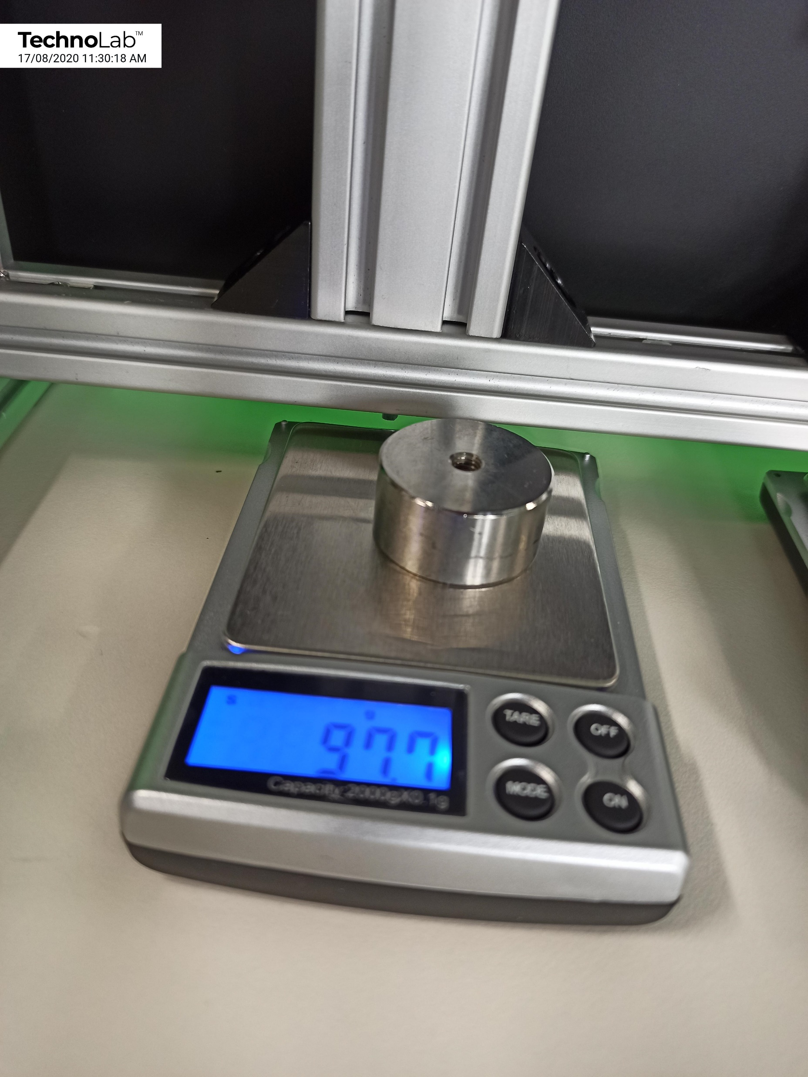
Applied
Load
Pv
97.7 g
Simply Supported Bar

Slide 20
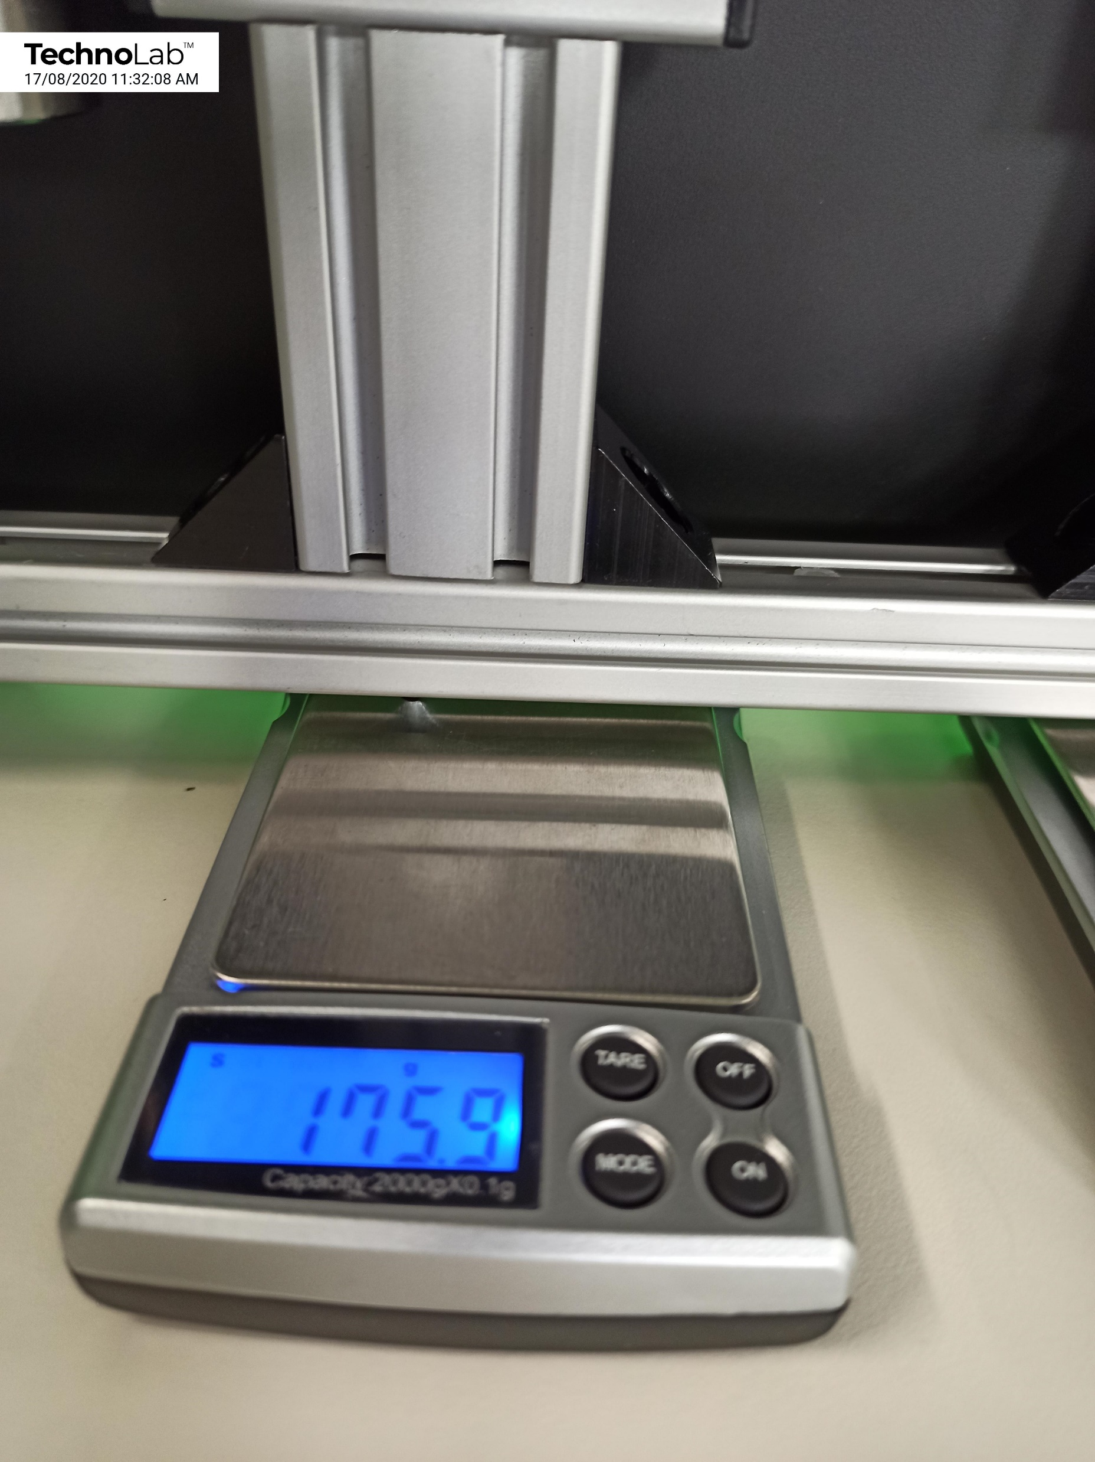
LHS
(free-roller)
Reaction
of the
Bar.
175.9 g
Simply Supported Bar

Slide 21
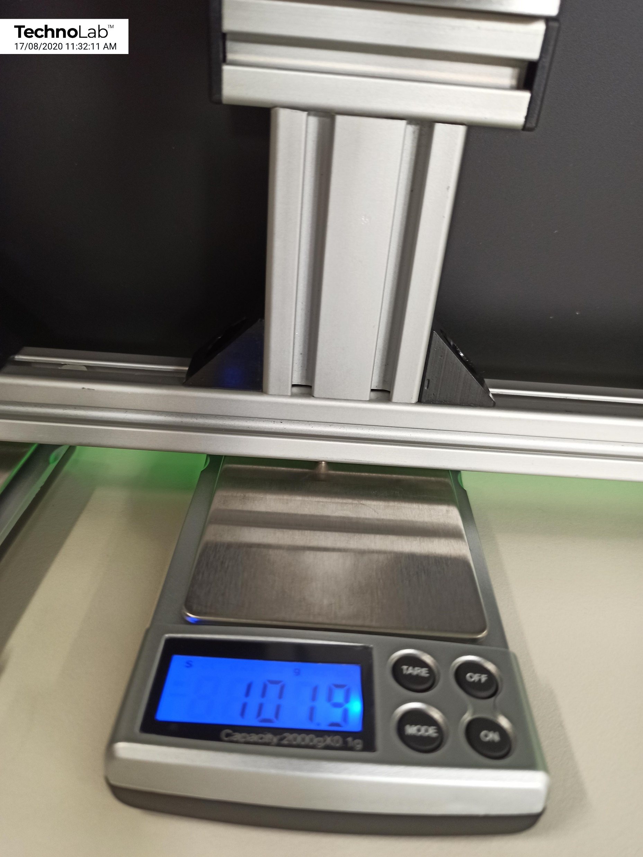
RHS
(propped-roller)
Reaction
of the
Bar.
101.9 g
Simply Supported Bar

Slide 22
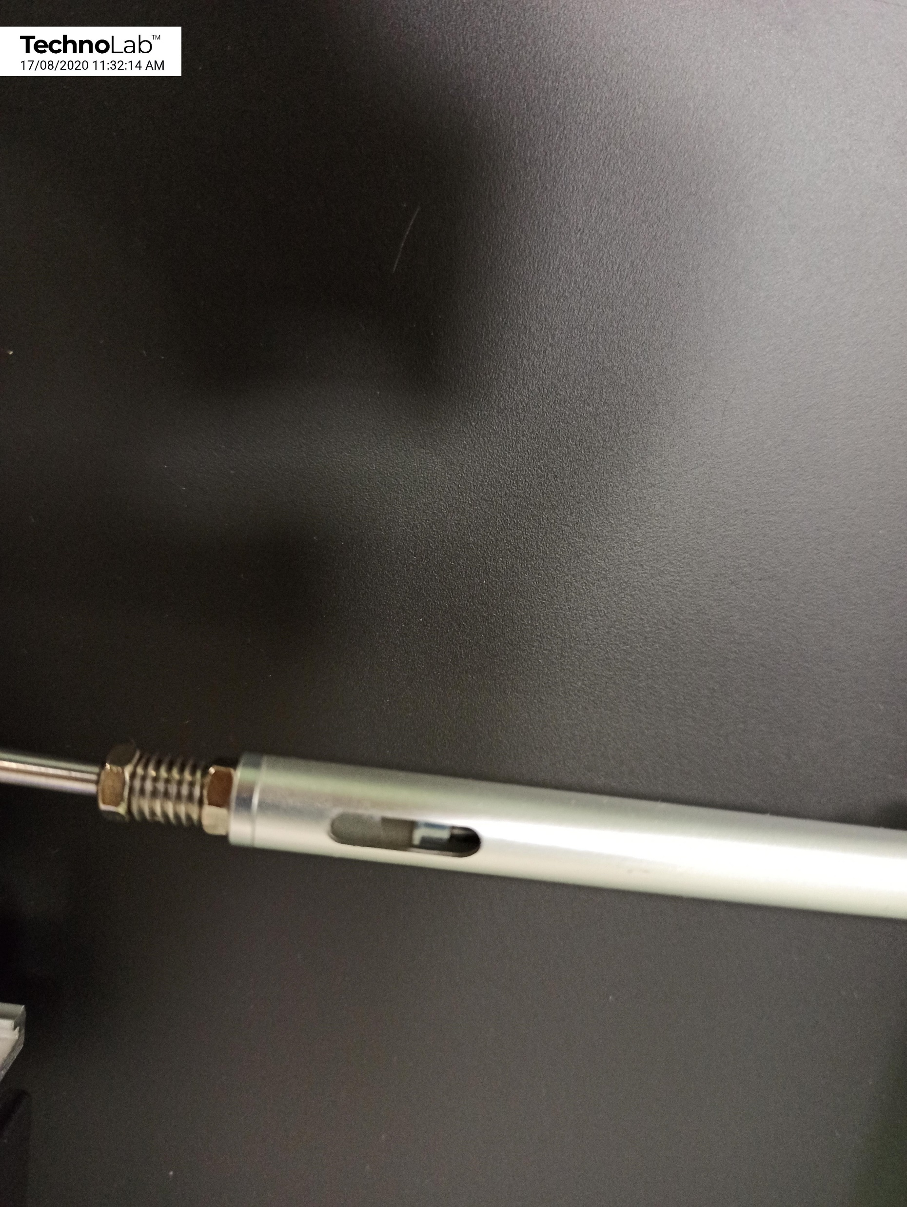
Prop Restraint:
Slot: Gap to Length Ratio
b = 82
b
L = 148.0
L
b
= 0.554
L
Simply Supported Bar

Slide 23
Experimental Results (V_{A} & V_{B}):
Reactions | V_{A} - LHS (gram) | V_{B} - RHS (gram)
Horizontal Load+3rd Vertical Load + Self-weight | 175.9 | 101.9
Self-Weight | 81.4 | 100.0
Applied Load (alone) | 94.5 | 1.9
Load (alone) | V_{A} =0.93 N | V_{B} = 0.019 N
Simply Supported Bar

Slide 24
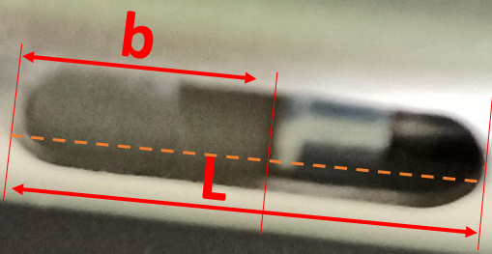
Experimental Results (H_{C}):
Prop Member Force (H_{C})
= Spring Stiffness (k_{s}) x Elongation
Elongation of Prop
= (Gap Length₁ – Gap Length₀)
Gap Length = True Slot Length (13.0 mm)
x Measured Gap/Slot_Length Ratio $\left(b/L\right)$
Prop Member Force (H_{C}) = k_{s} x 13.0 (${\left(b/L\right)}_{1}$ - ${\left(b/L\right)}_{0}$)
$${\left(b/L\right)}_{1}$$ | $${\left(b/L\right)}_{0}$$ | ${\left(b/L\right)}_{1}$ - ${\left(b/L\right)}_{0}$ | Force: H_{C} k_{s} x 13.0 (${\left(b/L\right)}_{1}$ - ${\left(b/L\right)}_{0}$)
0.484 | 0.554 | 0.07 | 0.91 N
$$k_{s}=$$
$$1.0N/mm$$
Simply Supported Bar

Slide 25
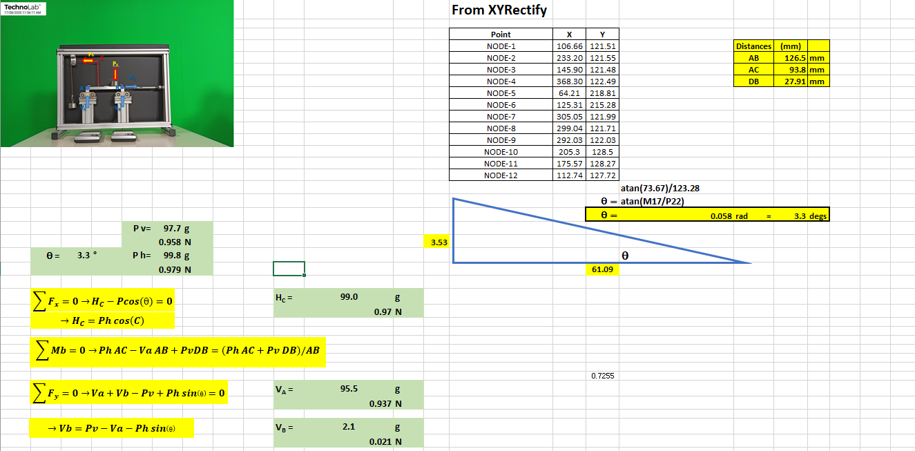
Theoretical Results (H_{C}, V_{A} & V_{B}):
From Spreadsheet
Simply Supported Bar

Slide 26
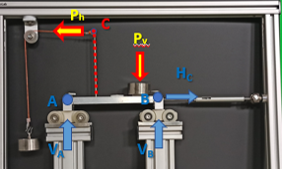
Theoretical Results (H_{B}, V_{A} & V_{B}):
“Good” Agreement
Approach | H_{C} (N) | V_{A} (N) | V_{B} (N)
Experimental | 0.91 | 0.93 | 0.019
Theoretical | 0.98 | 0.94 | 0.021
Simply Supported Bar

Slide 27
Concluding Remarks
“Good” agreement in Corresponding Results
from Theory & Experiment
Possible Sources of Error:
Angle of inclination slightly “out”
Accuracy of estimating Gap and Slit lengths of Prop
Rollers touching edges of support guides
Friction in reaction rod sliders
Friction in Loading Pulley
Simply Supported Bar

Slide 28
There are many more experiments and their results that are progressively being added to the four thematic Modules in www.Mechanics-Lab.com that are available for access to subscribing institutions. Please subscribe so that we can continue to progress the rate, range and extent of this valuable repository of experiments that supports the teaching & learning of fundamental engineering concepts and beyond.
Link to Subscription Page

