Slide 1

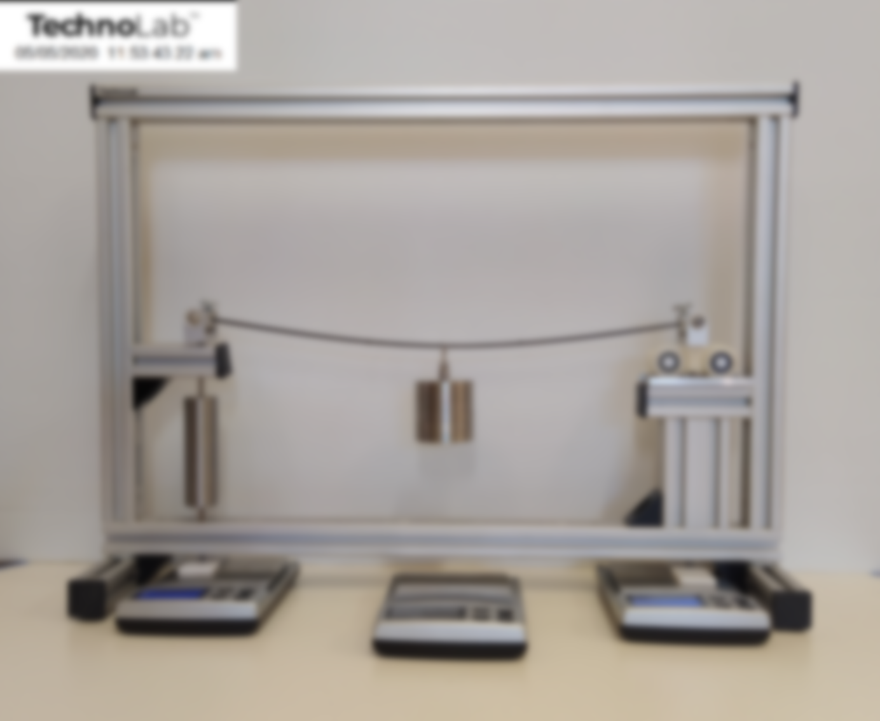
Experiment – 1 By Nicholas Haritos
Shear Force &
Bending Moment in
a Simply-Supported Beam

Slide 2
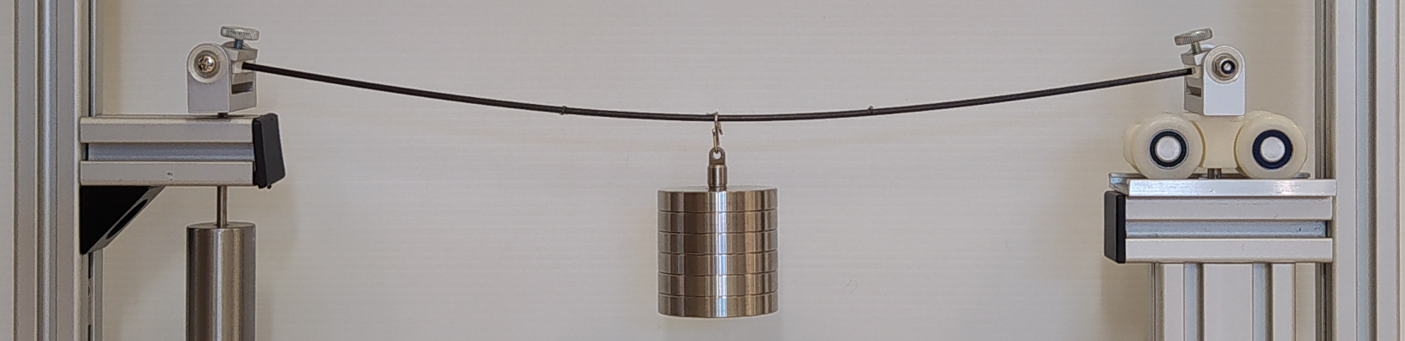

Test Model
Simply Supported Beam with Central Point Load (P)
x
Analytical Model
L
From Symmetry (ΣF_{y} = 0):
R₁ = R₂ = P/2
dx
R₁
P/2
P
R₂
P/2
Shear Force
.
V(x)
}
.
+
P
Bending
Moment
q(x)dx
M(x+dx)
P/2
V(x)
SFD
-
M(x)
.
P/2
M(x)
V(x+dx)
.
BMD
dx
+
PL/4
SF & BM in a SS Beam

Slide 3

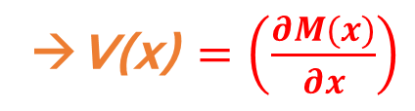


Vertical Force Equilibrium on the segment “dx”
Shear Force
V(x) + q(x)dx - V(x+dx) = 0
V(x)
Bending
Moment
q(x)dx
V(x) + q(x)dx – (V(x) + $\left(\frac{∂V(x)}{∂x}\right)$dx +O(2) ) = 0
M(x+dx)
M(x)
→ $\left(\frac{∂V(x)}{∂x}\right)$ = q(x)
V(x+dx)
dx
Moment Equilibrium of the segment “dx”
M(x+dx) – M(x) – V(x) dx +O(2) ) = 0
M(x) + $\left(\frac{∂M(x)}{∂x}\right)$dx +O(2) – M(x) = V(x) dx
→V(x)$=\left(\frac{∂M(x)}{∂x}\right)$
SF & BM in a SS Beam

Slide 4
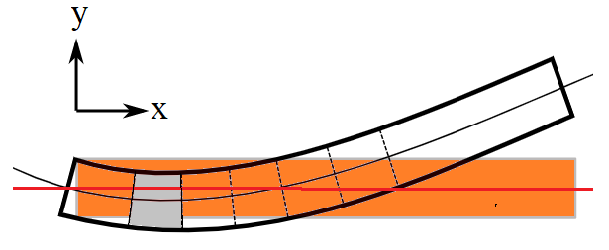
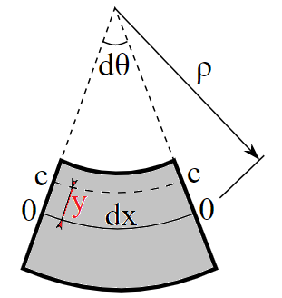
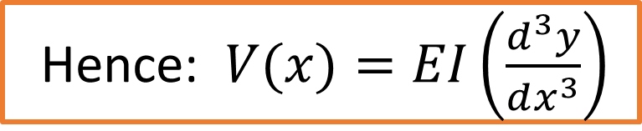
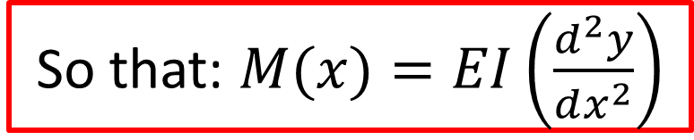
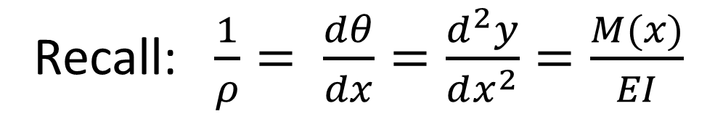
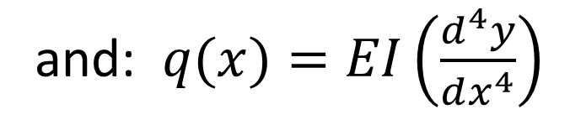
Moment-Curvature Relationship
dx = ρ dθ
Linear elastic beam (E = const) of uniform prismatic cross-section (I = second moment of area)
Recall: $\frac{1}{ρ}= \frac{dθ}{dx}=\frac{d^{2}y}{dx^{2}}=\frac{M(x)}{EI}$
So that: $M(x)=EI\left(\frac{d^{2}y}{dx^{2}}\right)$
Hence: $V(x)=EI\left(\frac{d^{3}y}{dx^{3}}\right)$
and: $q(x)=EI\left(\frac{d^{4}y}{dx^{4}}\right)$
SF & BM in a SS Beam

Slide 5
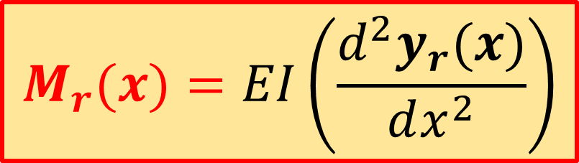
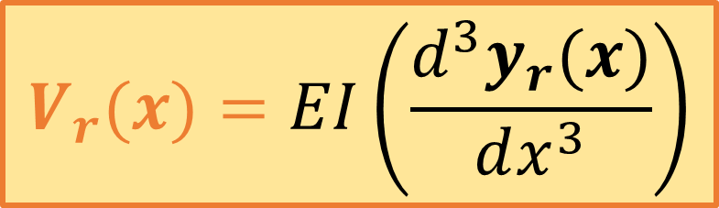
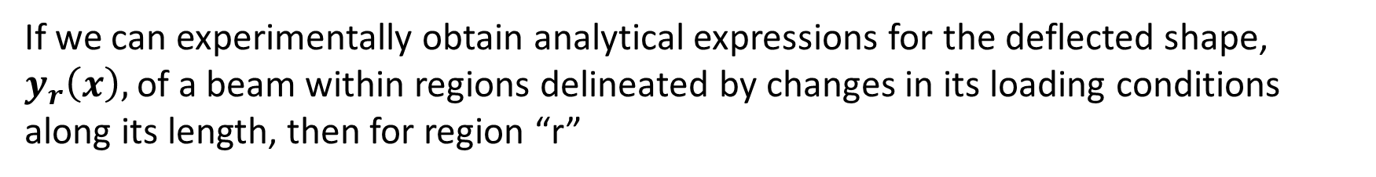
If we can experimentally obtain analytical expressions for the deflected shape, $y_{r}\left(x\right),$of a beam within regions delineated by changes in its loading conditions along its length, then for region “r”
$$M_{r}(x)=EI\left(\frac{d^{2}y_{r}(x)}{dx^{2}}\right)$$
$$V_{r}(x)=EI\left(\frac{d^{3}y_{r}(x)}{dx^{3}}\right)$$
We make use of photogrammetry to obtain the co-ordinates of several points on the deflected shape of a simply supported carbon-fibre beam with a single point load applied at centre-span. Curve fits to points within each of the two separate regions (y₁(x): for region from LHS pin-support to Point load location and y₁(x) for region from Point load location to RHS roller support) will then be used to obtain: M₁(x), V₁(x) and M₂(x), V₂(x).
SF & BM in a SS Beam

Slide 6
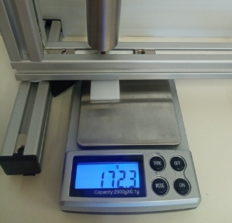
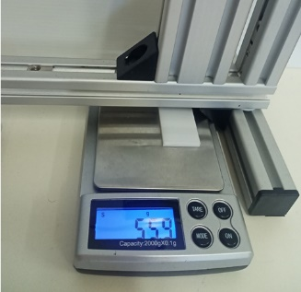
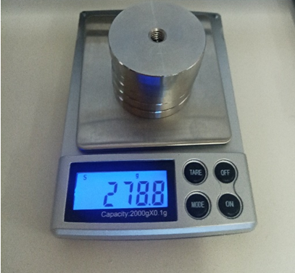
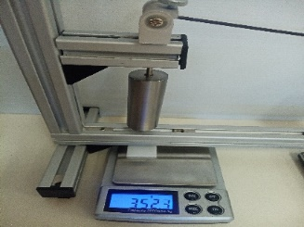
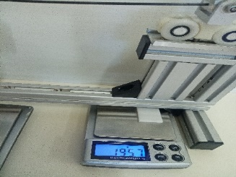
Test Model
Experimental investigation of a SS Beam with Central Point Load (P)
Load P = 0 N
Analytical Model
L
P = 278.8 g
172.3g
55.9g
Load P = 2.74 N
P
R₁
P/2
R₂
P/2
352.3g
195.7g
R₁ + R₂ = (1.77 + 1.37)N = 3.14 N (expt)
R₁ =(352.3-172.3)g
= 180.1 g = 1.77 N
R₂ =(195.7-55.9)g
= 139.8 g = 1.37N
compare: 1.37N + 1.37N = 2.74 N (theory)
SF & BM in a SS Beam

Slide 7
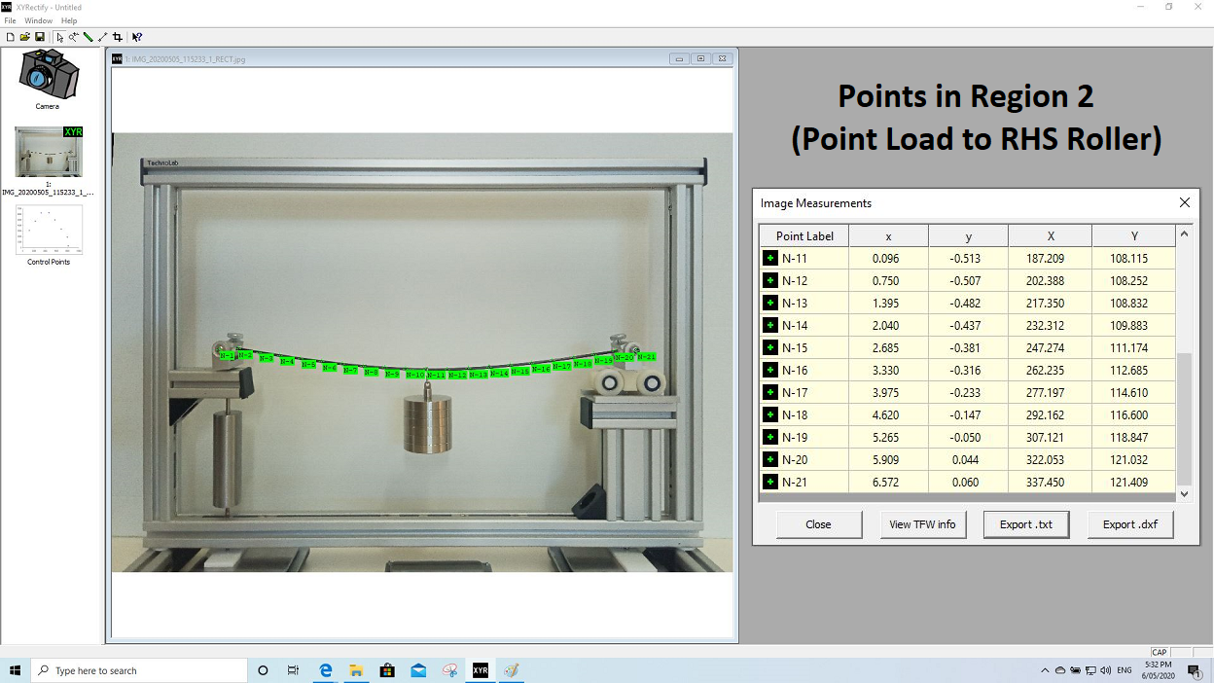
The co-ordinates of points on the Carbon Fibre beam that are clear of their attachment to the LHS Pin-joint support and RHS Roller support are identified anddetails extracted from a special version of XYRectify, from Photometrix.
(A perpetual licence containing the logo of the University that has purchased classroom replicates of bundled thematic sets of TechnoLab™ experiment kits, is made available by Strucomp P/L for the specific use by their students in their performance of TechnoLab™ experiments).
SF & BM in a SS Beam

Slide 8
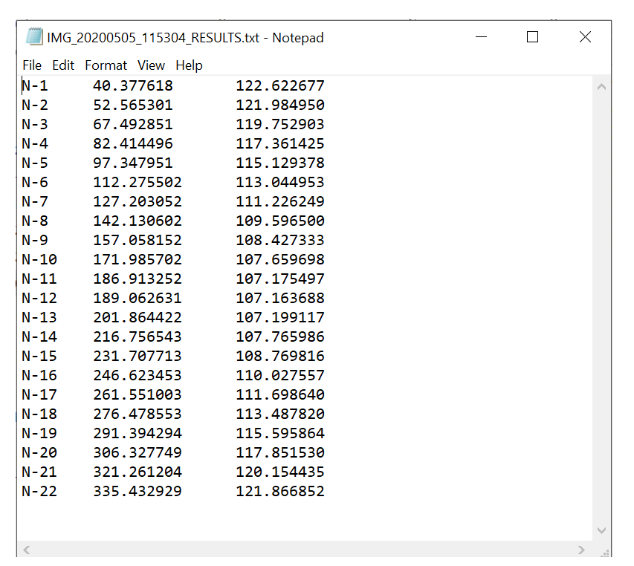
CSV File Contents (mm):
N-1 and N-22 – Refer to the Pin and Roller swivel co-ordinates.
(not used in curve fitting but identify the Length of beam)
N2 to N11 are the co-ordinates of points that lie in Segment#1 of the beam, with N11 just to the left of the loading hook on the beam.
N12 to N21 are the co-ordinates of points that lie in Segment#2 of the beam, with N12 just to the right of the loading hook on the beam.
SF & BM in a SS Beam

Slide 9
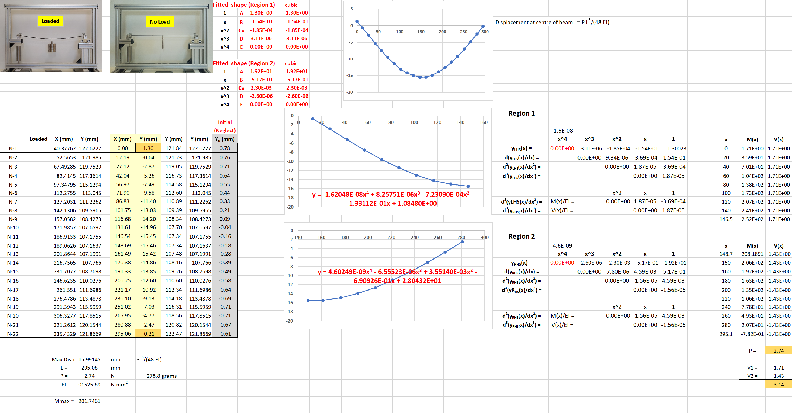
Refer to Cubic Fit Spreadsheet
SF & BM in a SS Beam

Slide 10
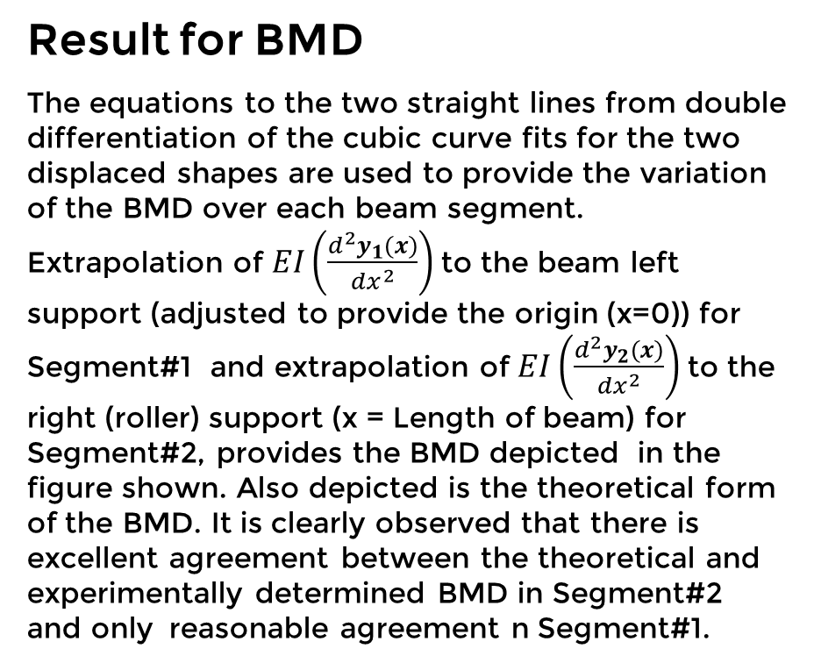
Result for BMD
The equations to the two straight lines from double differentiation of the cubic curve fits for the two displaced shapes are used to provide the variation of the BMD over each beam segment.
Extrapolation of $EI\left(\frac{d^{2}y_{1}(x)}{dx^{2}}\right)$to the beam left support (adjusted to provide the origin (x=0)) for Segment#1 and extrapolation of $EI\left(\frac{d^{2}y_{2}(x)}{dx^{2}}\right)$ to the right (roller) support (x = Length of beam) for Segment#2, provides the BMD depicted in the figure shown. Also depicted is the theoretical form of the BMD. It is clearly observed that there is excellent agreement between the theoretical and experimentally determined BMD in Segment#2 and only reasonable agreement n Segment#1.
SF & BM in a SS Beam

Slide 11
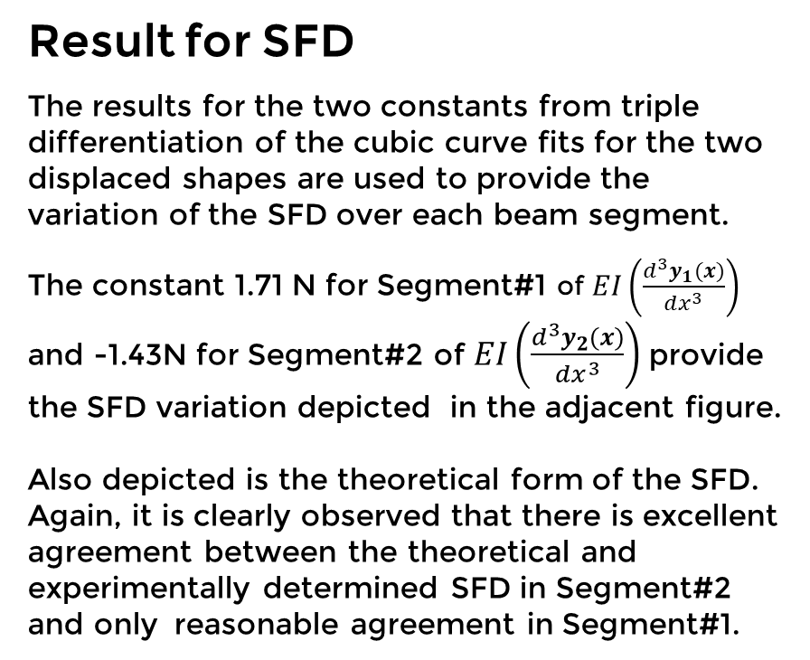
Result for SFD
The results for the two constants from triple differentiation of the cubic curve fits for the two displaced shapes are used to provide the variation of the SFD over each beam segment.
The constant 1.71 N for Segment#1 of $EI\left(\frac{d^{3}y_{1}(x)}{dx^{3}}\right)$ and -1.43N for Segment#2 of $EI\left(\frac{d^{3}y_{2}(x)}{dx^{3}}\right)$ provide the SFD variation depicted in the adjacent figure.
Also depicted is the theoretical form of the SFD. Again, it is clearly observed that there is excellent agreement between the theoretical and experimentally determined SFD in Segment#2 and only reasonable agreement in Segment#1.
SF & BM in a SS Beam

Slide 12
There are many more experiments, and their results, that are progressively being added to the four thematic Modules in www.Mechanics-Lab.com that are available for access to subscribing institutions.
Please subscribe so that we can continue to progress the rate, range and extent of this valuable repository of experiments that supports the teaching & learning of fundamental engineering concepts for now and beyond COVID-19 restictions.
Link to Subscription Page

