Slide 1
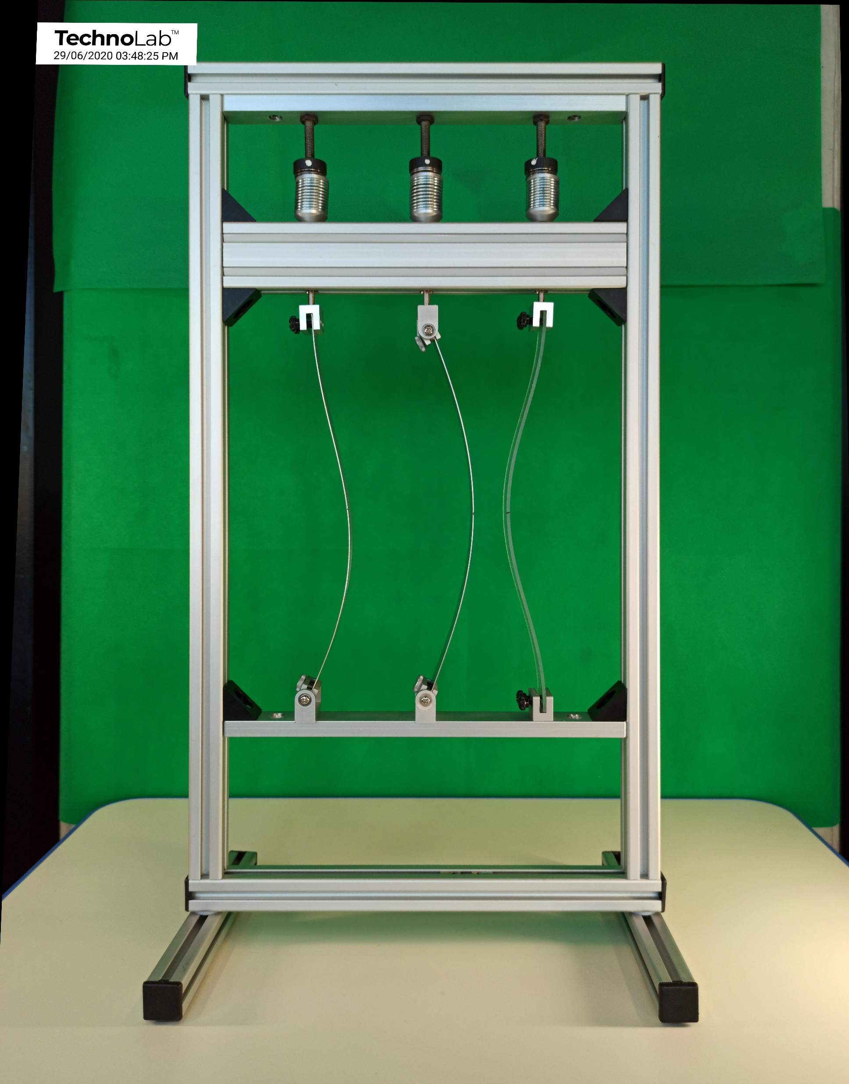
Experiment – 7 By STRUCOMP P/L
Buckling of a Fixed-Pinned
Column

Slide 2
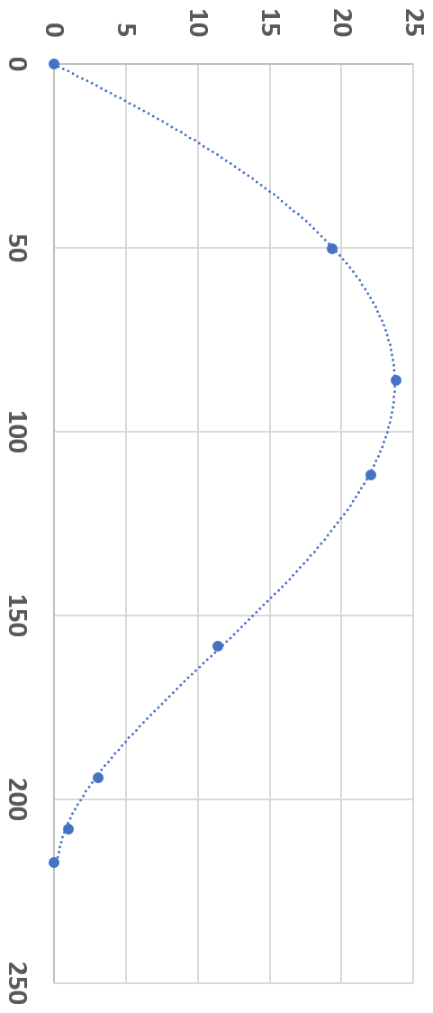
y (mm) displacement
Pinned
The buckling shape of a uniform linear elastic column with one end pinned and the other clamped (fixed) has been determined experimentally as shown.
The EXCEL least squares quartic polynomial of best fit to the observed points on the deflected shape is given by:
x (mm) position from bottom pin support
y = 5.271E-08x⁴ - 1.243E-05x³ - 2.187E-03x²
+ 5.441E-01x – 4.73E-02
What is the effective length of the column and the proportion of this length to the column length of 217mm ?
Clamp (fixed)
Buckling of a Fixed - Pinned Column

Slide 3
The point of contraflexure (where curvature changes sign in a flexed column) locates one end of a column’s effective length, viz where curvature = 0
$$\frac{d^{2}y}{{dx}^{2}}=0→\frac{d^{2}(5.271E−08x^{4}− 1.243E−05x^{3} − 2.187E−03x^{2}+ 5.224E−01x − 2.158E−02)}{{dx}^{2}}=0$$
$$\frac{dy}{dx}=4×5.271E−08x^{3}−3×1.243E−05x^{2} −2×2.187E−03x+ 5.224E−01$$
$$\frac{d^{2}y}{{dx}^{2}}=3×4×5.271E−08x^{2}−2×3×1.243E−05x−2×2.187E−03=0$$
$$0.6325E−06x^{2}−7.548E−05x−4.374E−03=0$$
$$x=\frac{7.548E−05±\sqrt{{(7.548E−05)}^{2} + 4×0.6325E−06×4.374E−03}}{2×0.6325E−06}=58.7±101.7=−42.9 or 160.4 mm$$
160.4 $mm$
Buckling of a Pin-ended Column

Slide 4
Experimental Result
y (mm) displacement
Pinned
Effective Length
$$ℓ_{e}=x_{c}=160.4 mm$$
Column Length
$$x_{c}=160.4 mm$$
L = 217 mm
$$\frac{ℓ_{e}}{L}= \frac{160.4}{217}=0.74$$
217mm
x (mm) position from bottom pin support
Theoretical Result
$$\frac{ℓ_{e}}{L}= \frac{1}{\sqrt{2.046}}=0.699 ≈0.70$$
Good Agreement
Point of contraflexure
Clamp (fixed)
Buckling of a Fixed - Pinned Column

Slide 5
Concluding Remarks
An investigation was performed to determine the effective length of a slender column with one end pinned and its other end clamped.
A 4th order polynomial fit was performed to the deflected shape of the column under high axial compressive load as observed at number of key points (8 off) along its length.
This shape was investigated to identify the point of contraflexure which then allowed the Column’s “Effective buckling length” to be determined, and hence the ratio of this length to the actual length of the column.
The experimentally determined value of this ratio of 0.74 compared reasonable favourably to 0.70 that applies to the theoretical value of this ratio for the Fixed-Pinned support conditions of this column.
Buckling of a Fixed - Pinned Column

Slide 6
Concluding Remarks
“Reasonably Good” agreement in Correspondance
of Results Theory to Experiment
Possible Sources of Error:
Possible non uniformity of the rectangular cross-section of the column
Friction in the swivel that acts as the Pin support at one end of the column
The clamp fixture at the other support end of the column is not “perfectly” rigid
Other ?
Buckling of a Fixed - Pinned Column

Slide 7
There are many more experiments and their results that are progressively being added to the four thematic Modules in www.Mechanics-Lab.com that are available for access to subscribing institutions. Please subscribe so that we can continue to progress the rate, range and extent of this valuable repository of experiments that supports the teaching & learning of fundamental engineering concepts and beyond.
Link to Subscription Page

