Slide 1

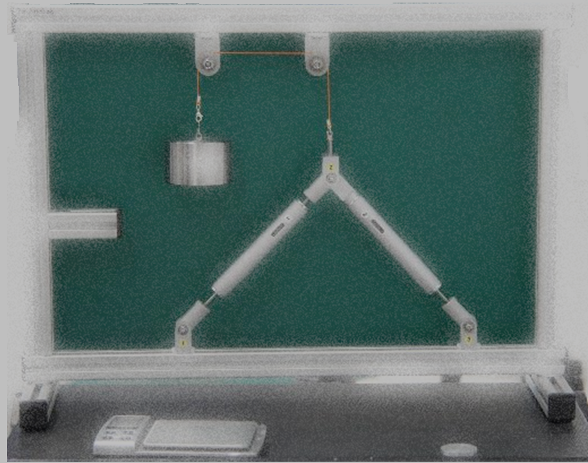
Experiment – 1 By Nicholas Haritos
Member Forces in
a 2-bar Truss

Slide 2
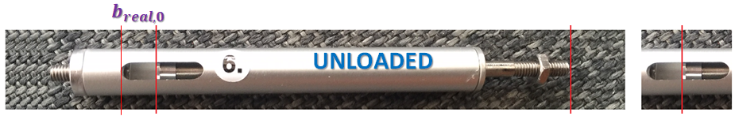



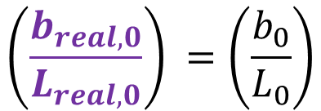
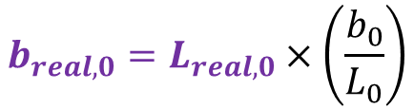
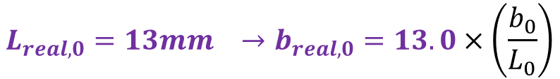
We use a simplified form of photogrammetry to perform measurements of the elongation (or contraction) of the internally sprung Truss members/bars
Let us consider a Pin-jointed Truss member in “isolation” prior to any load being applied to the Truss – its “unloaded” condition (state “0”)
Photo
$$\left(\frac{b_{real,0}}{L_{real,0}}\right) =\left(\frac{b_{0}}{L_{0}}\right)$$
The “real” Truss member’s gap length is:
$$b_{real,0}=L_{real,0}×\left(\frac{b_{0}}{L_{0}}\right)$$
is the same in photo dimensions as for the real dimensions
$${L_{real,0}=13mm →b}_{real,0}=13.0×\left(\frac{b_{0}}{L_{0}}\right)$$
(For all Truss members)
2-bar Truss

Slide 3
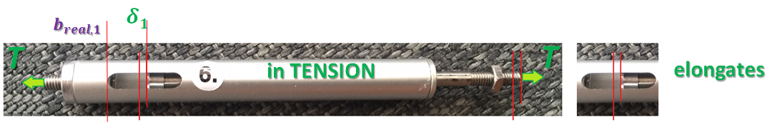
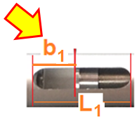
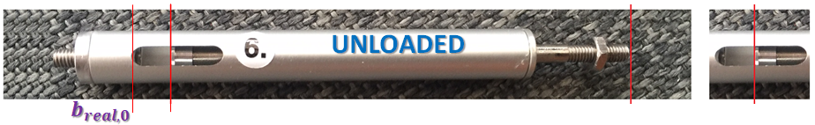

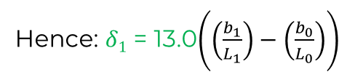
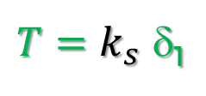
We use a simplified form of photogrammetry to perform measurements of the elongation (or contraction) of the internally sprung Truss members/bars
Let us consider the same Pin-jointed Truss member in “isolation” after load state “1” has been applied to the Truss, and this member is now in Tension
Image
So:
$T=k_{s}$ δ₁
As previously, we can say:
And that: extension $δ1$ = (b_{real,1} - b_{real,0} )
Hence: $δ1$ = 13.0$\left(\left(\frac{b_{1}}{L_{1}}\right)−\left(\frac{b_{0}}{L_{0}}\right)\right)$
$$\left(\frac{b_{real,1}}{L_{real,1}}\right) =\left(\frac{b_{1}}{L_{1}}\right)$$
Truss Spring
Stiffness
2-bar Truss

Slide 4
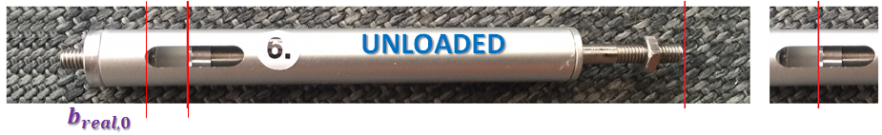
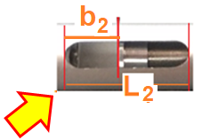
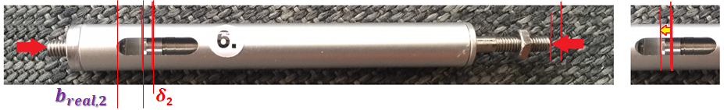

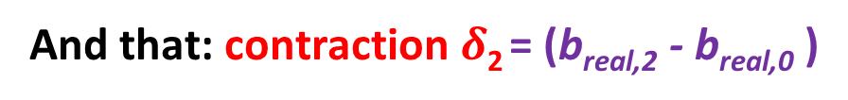

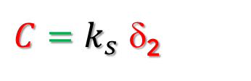
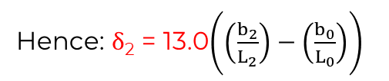
We use a simplified form of photogrammetry to perform measurements of the elongation (or contraction) of the internally sprung Truss members/bars
Let us consider the same Pin-jointed Truss member in “isolation” after load state “2” has been applied to the Truss, and this member is now in Compression
Similarly for Members in Compression
Photo Image
$δ$₂
C
C
contracts
As previously, we can say:
And that: contraction$δ$₂ = (b_{real,2} - b_{real,0} )
So:
$C=k_{s}$ δ₂
$$\left(\frac{b_{real,2}}{L_{real,2}}\right) =\left(\frac{b_{2}}{L_{2}}\right)$$
Hence: $δ$₂ = 13.0$\left(\left(\frac{b_{2}}{L_{2}}\right)−\left(\frac{b_{0}}{L_{0}}\right)\right)$
Truss Spring
Stiffness
2-bar Truss

Slide 5

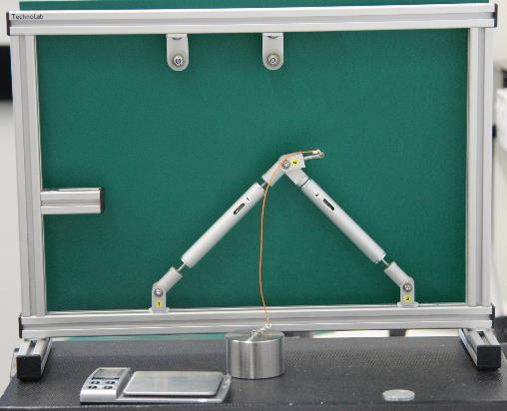
2-bar Truss Experiment – 1
Case: No Load
2-bar Truss

Slide 6
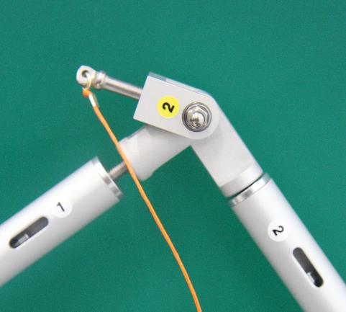
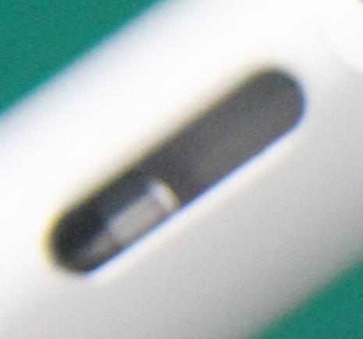
Member#1
L
b = 67.0
L = 123.0
b
b
= 0.545
L
2-bar Truss

Slide 7
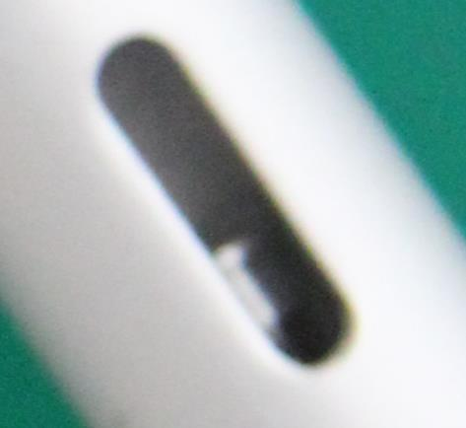
Member#2
b = 72.5
L
b
L = 121.0
b
= 0.599
L
2-bar Truss

Slide 8
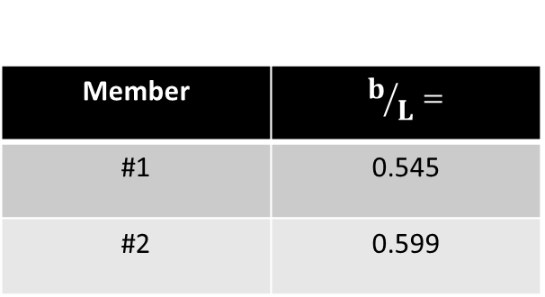
2-bar Truss Experiment
Case: No Load
Member | $$b/L=$$
#1 | 0.545
#2 | 0.599
2-bar Truss

Slide 9
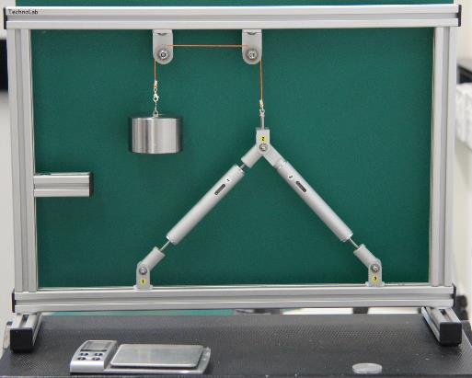
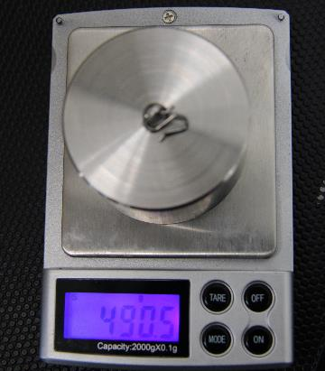
2-bar Truss Experiment
Case: Central load
490.5 g
x
9.81/1000
= 4.89 N
2-bar Truss

Slide 10
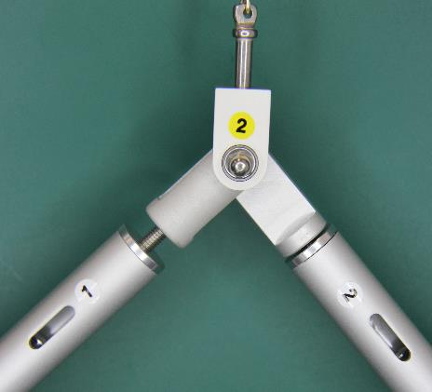
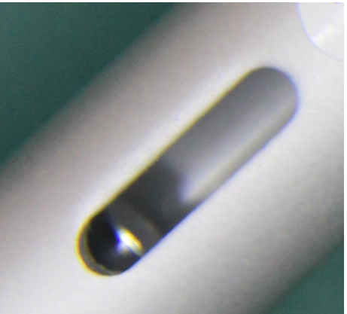
Member#1
b = 98.5.0
L
L = 120.5
b
b
= 0.817
L
2-bar Truss

Slide 11
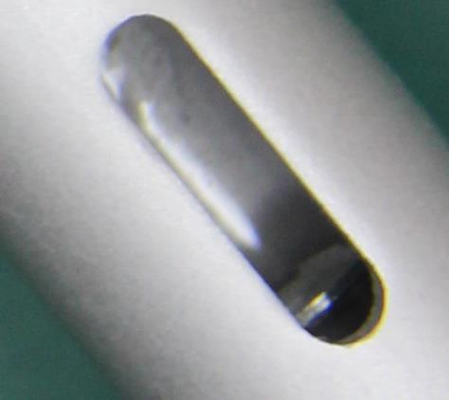
Member#2
b = 113.0
L
L = 133.0
b
b
= 0.850
L
2-bar Truss

Slide 12
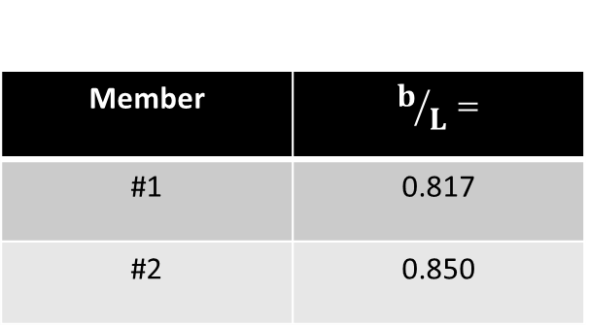
2-bar Truss Experiment
Case: Central load
Member | $$b/L=$$
#1 | 0.817
#2 | 0.850
2-bar Truss

Slide 13
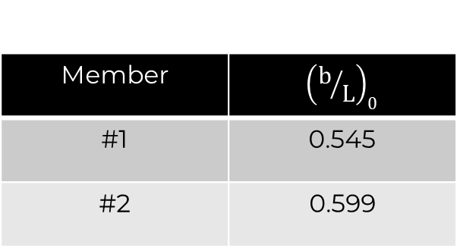
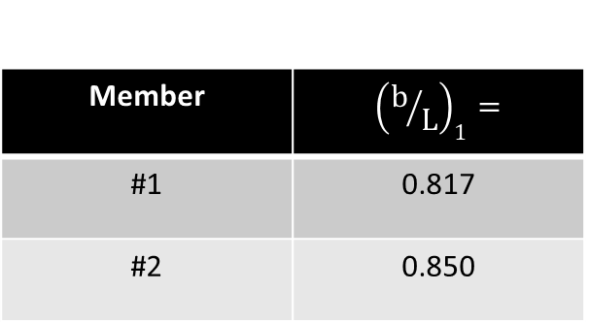
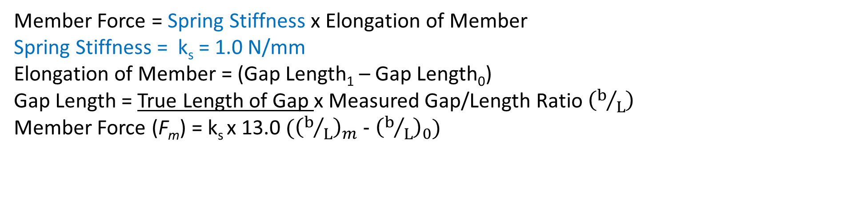
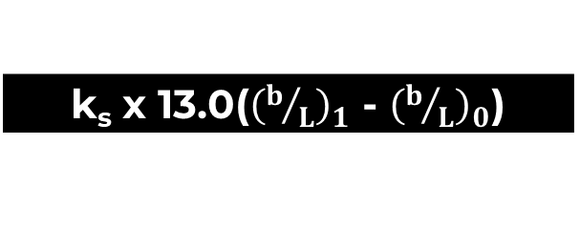
Member Forces by Experiment
Member Force = Spring Stiffness x Elongation of Member
Spring Stiffness = k_{s} = 1.0 N/mm
Elongation of Member = (Gap Length₁ – Gap Length₀)
Gap Length = True Length of Gap x Measured Gap/Length Ratio $\left(b/L\right)$
Member Force (F_{m}) = k_{s} x 13.0 (${\left(b/L\right)}_{m}$ - ${\left(b/L\right)}_{0}$)
No Load | 498.5g (= 4.89 N)
k_{s} x 13.0(${\left(b/L\right)}_{1}$ - ${\left(b/L\right)}_{0}$)
Member | $${\left(b/L\right)}_{1}=$$
#1 | 0.817
#2 | 0.850
Member | $${\left(b/L\right)}_{0}$$
#1 | 0.545
#2 | 0.599
Member | Force (N)
#1 | 3.54
#2 | 3.26
2-bar Truss

Slide 14

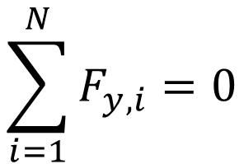
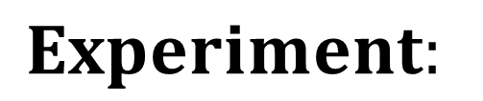

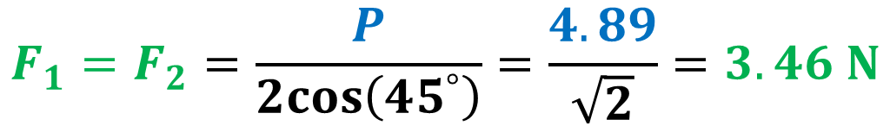
Member Forces by Equilibrium Analysis (#1)
From symmetry, F₁ = F₂
P
$$\sum_{i=1}^{N}{F_{y,i}}=0$$
Vertical Force Equilm.
.
.
F₁
F₂
$$P −2F_{1}\cos\left(45^{°}\right)=0$$
45°
45°
$$F_{1}=F_{2}=\frac{P}{2cos\left(45^{°}\right)}=\frac{4.89}{\sqrt{2}}=3.46 N$$
~ 5% error on values
$$Experiment:$$
$$F_{1}={3.54N; F}_{2}=3.26N$$
2-bar Truss

Slide 15
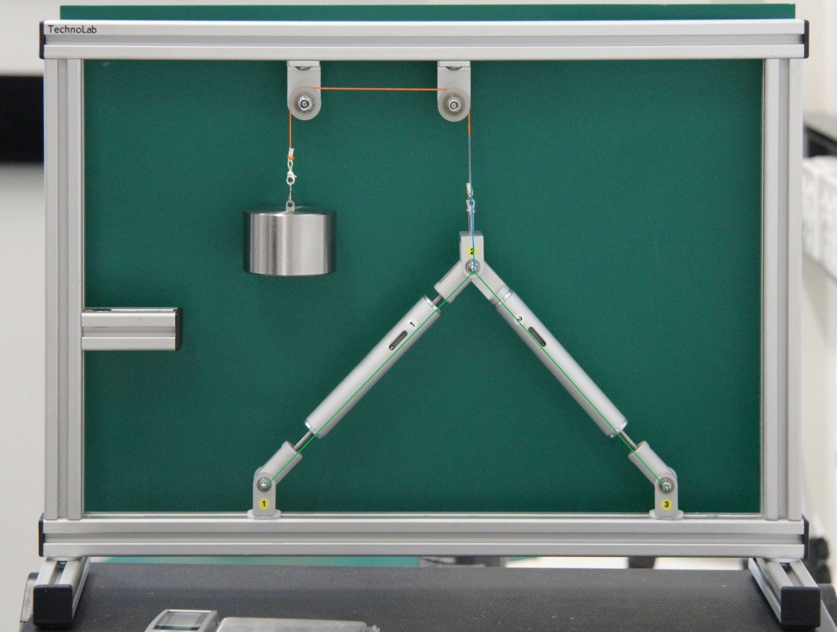
Member Forces by Vector Analysis(#2)
Orientation of
Members & Load
Rectified Image (XYRectify)
2-bar Truss

Slide 16
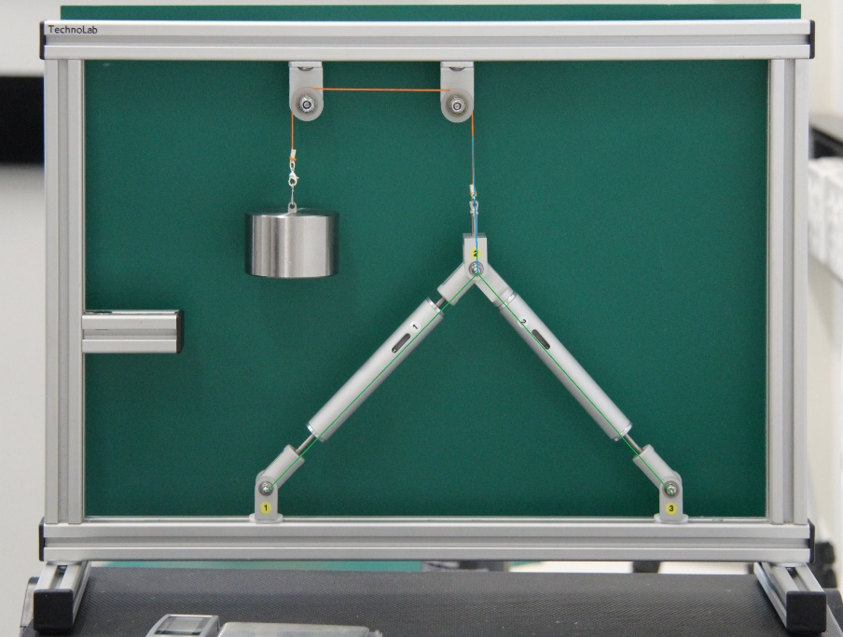

eg Use a Scale of 2cm to 1 N so 4.89 N → 9.78 cm
4.89N
4.89N
9.78cm
2-bar Truss

Slide 17

Member Forces by Analysis-2 (cont)
6.80cm → 3.40N
4.89N
6.6cm → 3.3N
2-bar Truss

Slide 18
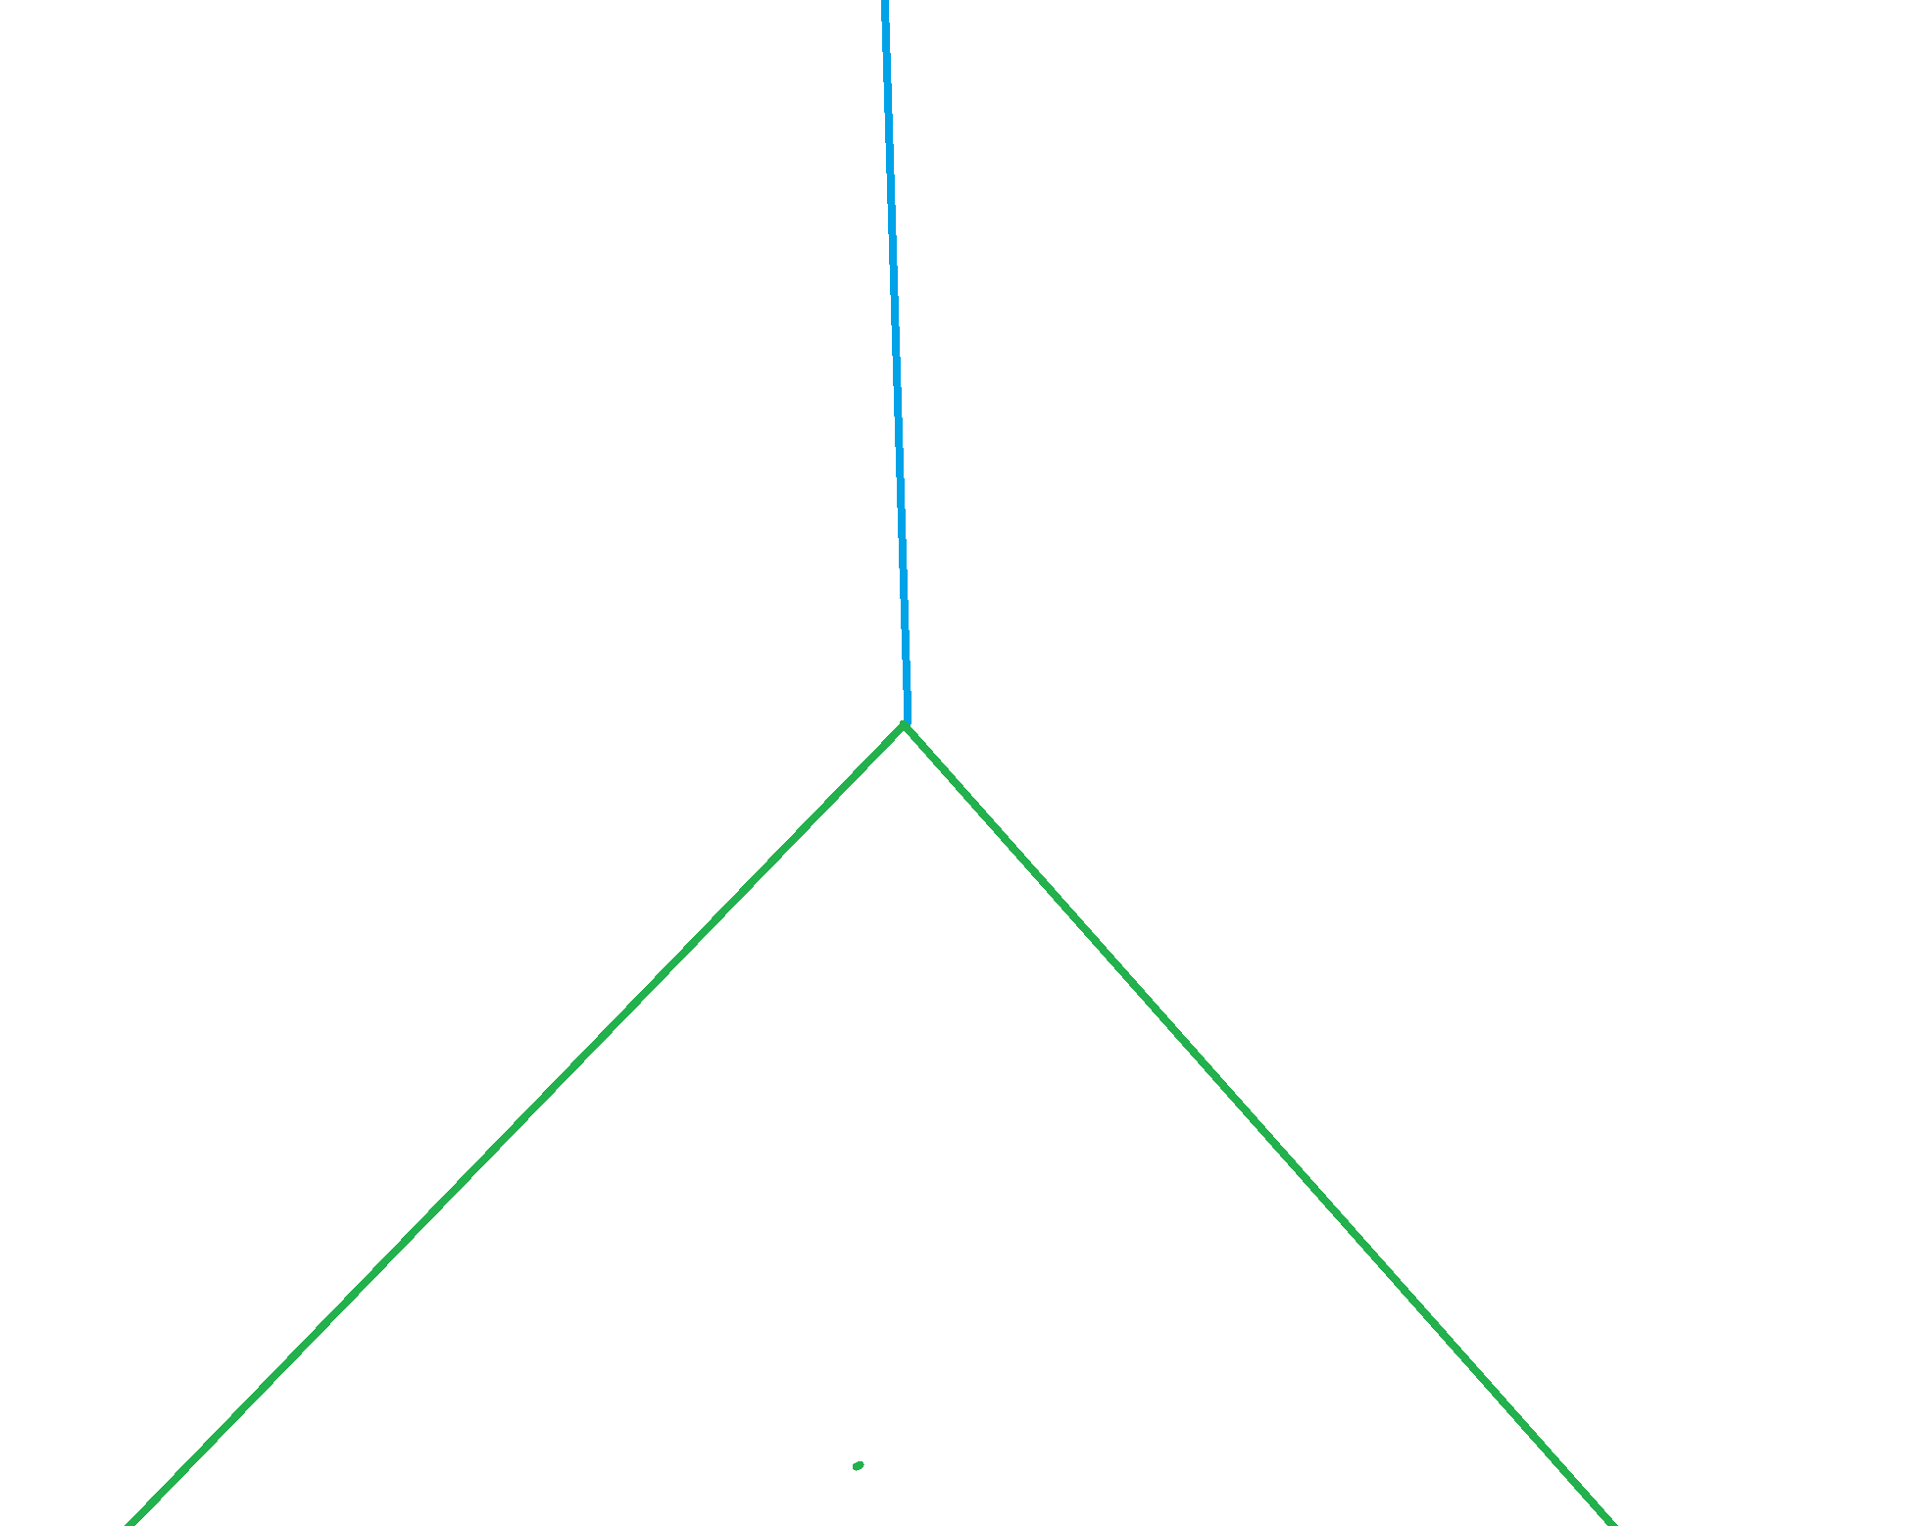
Observed Member Forces: Error Analysis
3.54
4.89
3.26
Error ~ 10%
2-bar Truss

Slide 19
There are many more experiments and their results that are progressively being added to the four thematic Modules in www.Mechanics-Lab.com that are available for access to subscribing institutions.
Please subscribe so that we can continue to progress the rate, range and extent of this valuable repository of experiments that supports the teaching & learning of fundamental engineering concepts and beyond.
Link to Subscription Page

