Slide 1

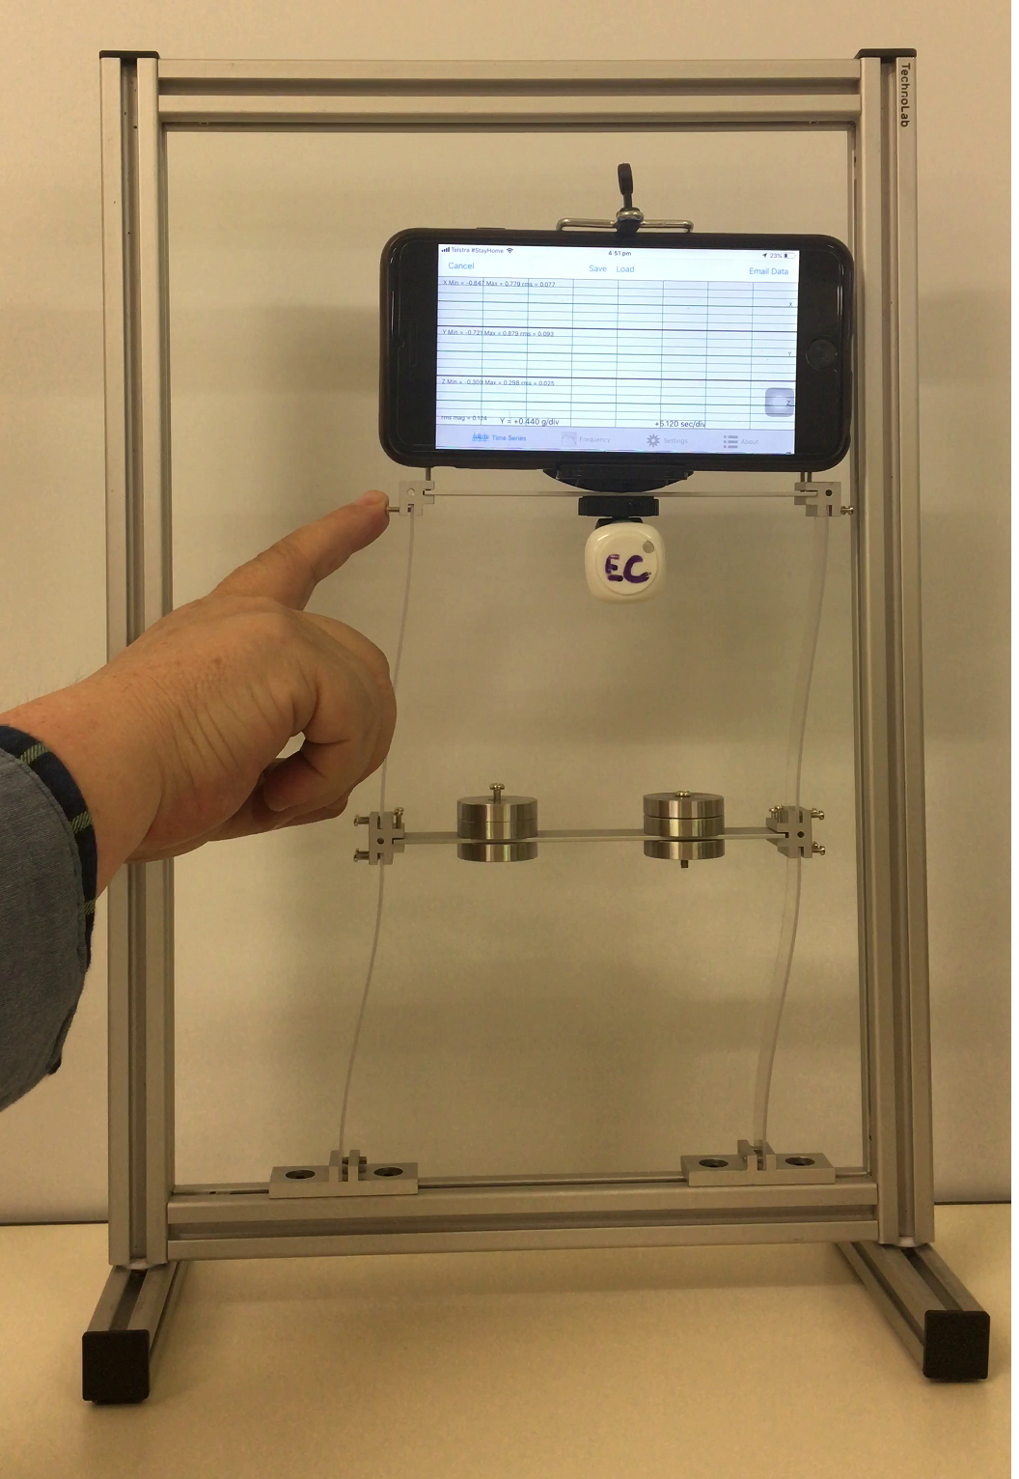
Dynamics Characteristics of a 2-Storey Sway Frame
Experiment by STRUCOMP P/L
SDOF Approximation

Slide 2


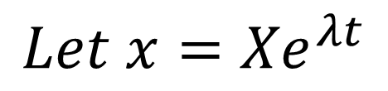
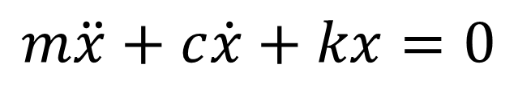
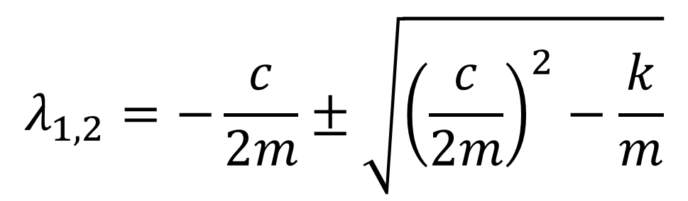
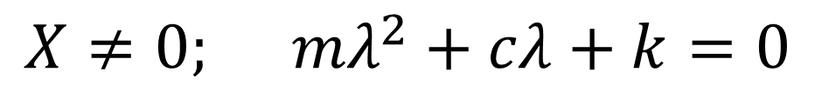
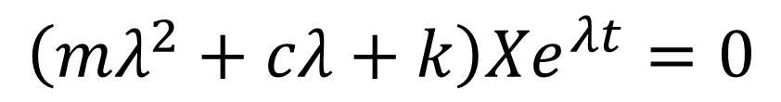
Theory: Free Vibration SDOF Viscous-damped System
x
$$m\ddot{x}+c\dot{x}+kx=0$$
k
$$Let x={Xe}^{λt}$$
m
c
$$\left(mλ^{2}+cλ+k\right){Xe}^{λt}=0$$
$$X≠0; mλ^{2}+cλ+k=0$$
$$λ_{1,2}=−\frac{c}{2m}±\sqrt{{\left(\frac{c}{2m}\right)}^{2}−\frac{k}{m}}$$
SDOF Approximation (2-storey Sway Frame)

Slide 3
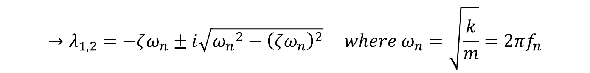
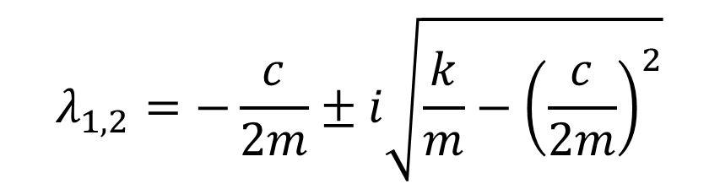
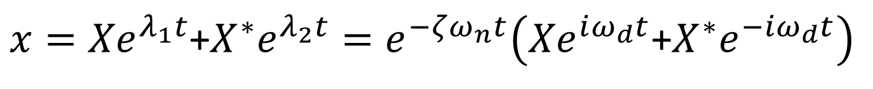

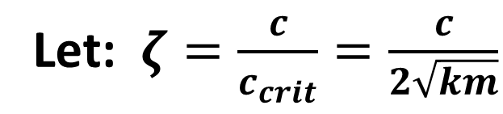

Free Vibration SDOF Viscous-damped system
$${c<c}_{crit}(=2\sqrt{km})$$
Case 4: “Sub - Critical” Damping:
$$λ_{1,2}=−\frac{c}{2m}±i\sqrt{\frac{k}{m}−{\left(\frac{c}{2m}\right)}^{2}}$$
Let: $ζ=\frac{c}{c_{crit}}=\frac{c}{2\sqrt{km}}$
$$→λ_{1,2}=−ζω_{n}±i\sqrt{{ω_{n}}^{2}−{\left(ζω_{n}\right)}^{2}} where ω_{n}=\sqrt{\frac{k}{m}}=2πf_{n}$$
$$λ_{1,2}=−ζω_{n}±iω_{n}\sqrt{1−ζ^{2}} →$$
$$λ_{1,2}=−ζω_{n}±iω_{d} where ω_{d}=ω_{n}\sqrt{1−ζ^{2}}$$
$x={Xe}^{λ_{1}t}$+${X^{∗}e}^{λ_{2}t}=e^{−ζω_{n}t}\left({Xe}^{iω_{d}t}\text{+}{X^{∗}e}^{−iω_{d}t}\right)$
$$x(t)=e^{−ζω_{n}t}\left(Acos\left(ω_{d}t\right) \text{+ }\text{Bsin}\left(ω_{d}t\right)\right)$$
SDOF Approximation (2-storey Sway Frame)

Slide 4
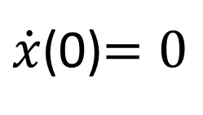
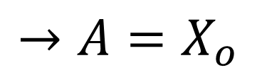
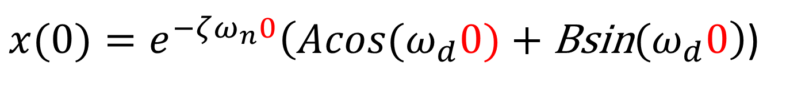
Free Vibration SDOF Viscous-damped system
$${c<c}_{crit}(=2\sqrt{km})$$
Case 4: “Sub - Critical” Damping:
“Pluck Test” Release from rest:$x(0) =X_{o}$;
$\dot{x}$(0)$=0$
$x(0)=e^{−ζω_{n}0}\left(Acos{(ω}_{d}0)\text{ + }\text{Bsin}{(ω}_{d}0\right)$)
$$→A=X_{o}$$
$$\dot{x}(t)={−ζω_{n}e}^{−ζω_{n}t}\left(Acos\left(ω_{d}t\right)\text{+}\text{Bsin}\left(ω_{d}t\right)\right)$$
$$+e^{−ζω_{n}t}ω_{d}\left(−Asin\left(ω_{d}t\right)\text{+}\text{B}cos\left(ω_{d}t\right)\right)$$
SDOF Approximation (2-storey Sway Frame)

Slide 5
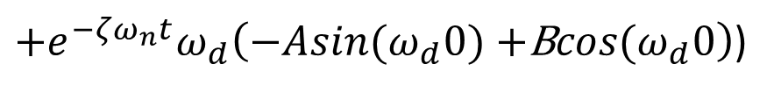

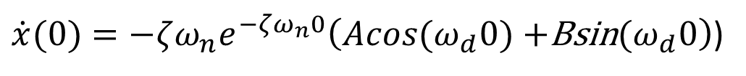
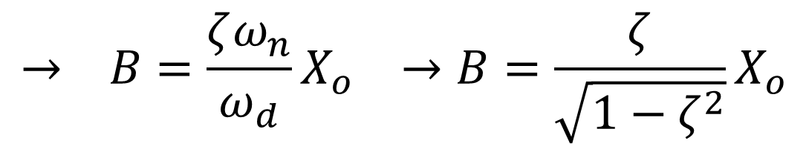
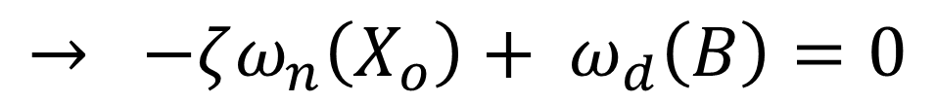

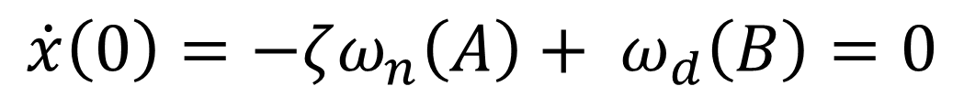
“Pluck Test”: Release from rest $\dot{x}\left(0\right)=$ 0
$\dot{x}(0)={−ζω_{n}e}^{−ζω_{n}0}\left(Acos{(ω}_{d}0)\text{ +}\text{Bsin}{(ω}_{d}0\right)$)
$+e^{−ζω_{n}t}ω_{d}\left(−Asin{(ω}_{d}0)\text{ +}\text{B}cos{(ω}_{d}0\right)$)
$$\dot{x}\left(0\right)=−ζω_{n}\left(A\right)+ ω_{d}\left(B\right)=0$$
$$→ −ζω_{n}\left(X_{o}\right)+ ω_{d}\left(B\right)=0$$
$$→ B=\frac{ζω_{n}}{ω_{d}}X_{o} →B=\frac{ζ}{\sqrt{1−ζ^{2}}}X_{o}$$
$$x(t)={X_{o}^{}e}^{−ζω_{n}t}\left(cos\left(ω_{d}t\right)\text{+}\frac{ζ}{\sqrt{1−ζ^{2}}}\text{sin}\left(ω_{d}t\right)\right)$$
SDOF Approximation (2-storey Sway Frame)

Slide 6
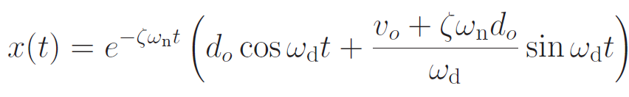
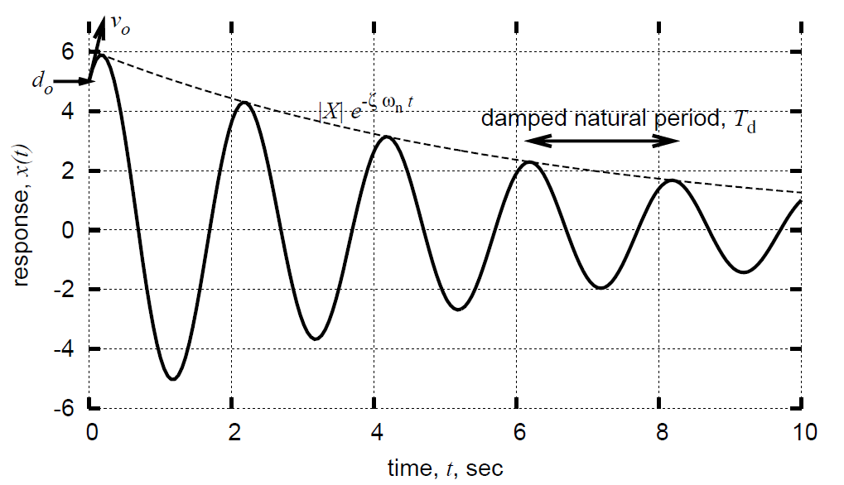
Free Vibration SDOF Viscous-damped system
Release a$t t=0: x(0) =d_{o}$ with initial velocity $\dot{x}$(0)$=v_{o}$
SDOF Approximation (2-storey Sway Frame)

Slide 7
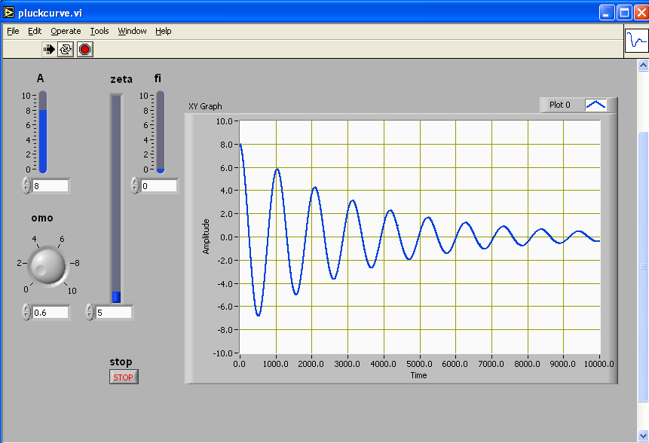
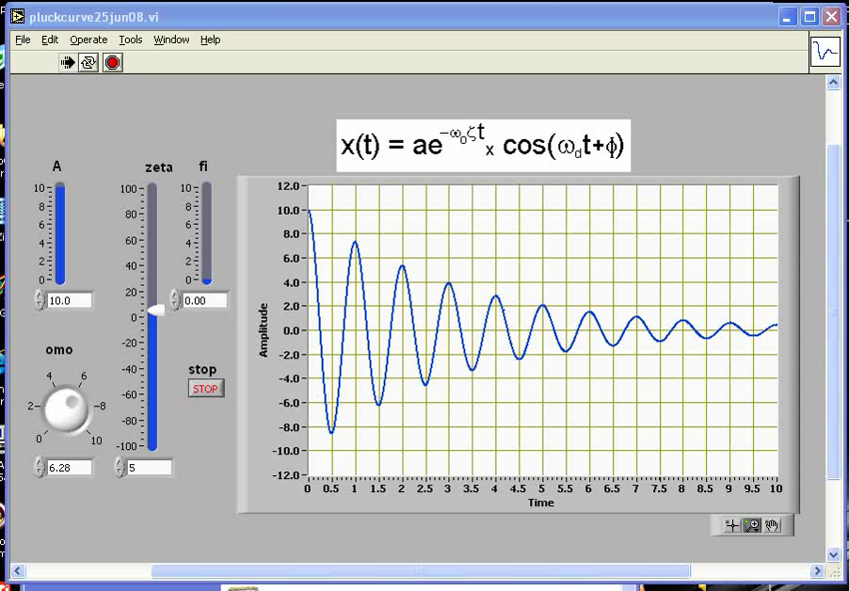
SDOF Approximation (2-storey Sway Frame)

Slide 8
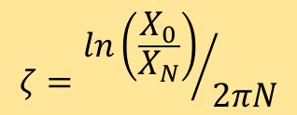
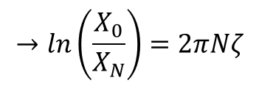
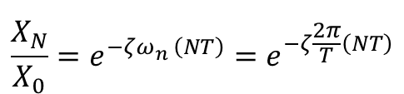

Evaluating natural frequency f_{n} & damping ratio ζ
natural frequency f_{n}
0
$$f_{n}=\frac{N}{t_{N}−t_{0}}$$
1
damping ratio ζ
2
. . . . . . . .
$$\frac{X_{N}}{X_{0}}=\frac{e^{−ζω_{n}^{}\left(t_{0}+NT\right)}}{e^{−ζω_{n}^{}t_{0}}}$$
N
1
$$\frac{X_{N}}{X_{0}}=e^{−ζω_{n}^{}\left(NT\right)}=e^{−ζ\frac{2π}{T}\left(NT\right)}$$
$$→ln\left(\frac{X_{0}}{X_{N}}\right)=2πNζ$$
t₀
t_{N}
$$ζ={ln\left(\frac{X_{0}}{X_{N}}\right)}/{2πN}$$
SDOF Approximation (2-storey Sway Frame)

Slide 9
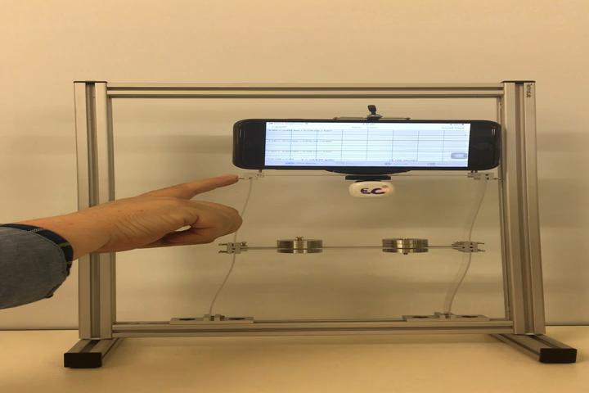
Experimental Identification
SDOF Approximation (2-storey Sway Frame)

Slide 10
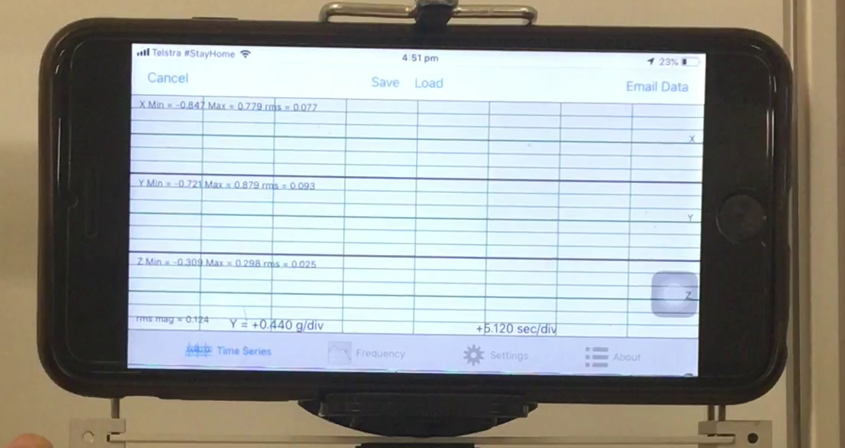
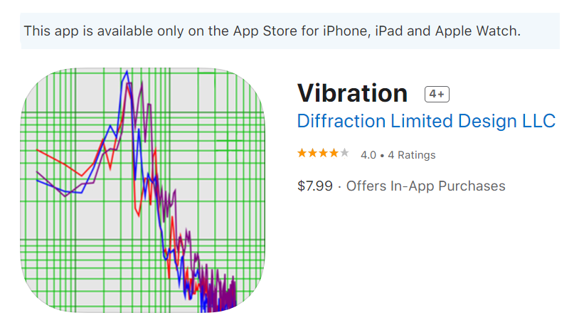
X
Z
Y
(out of
page)
SDOF Approximation (2-storey Sway Frame)

Slide 11
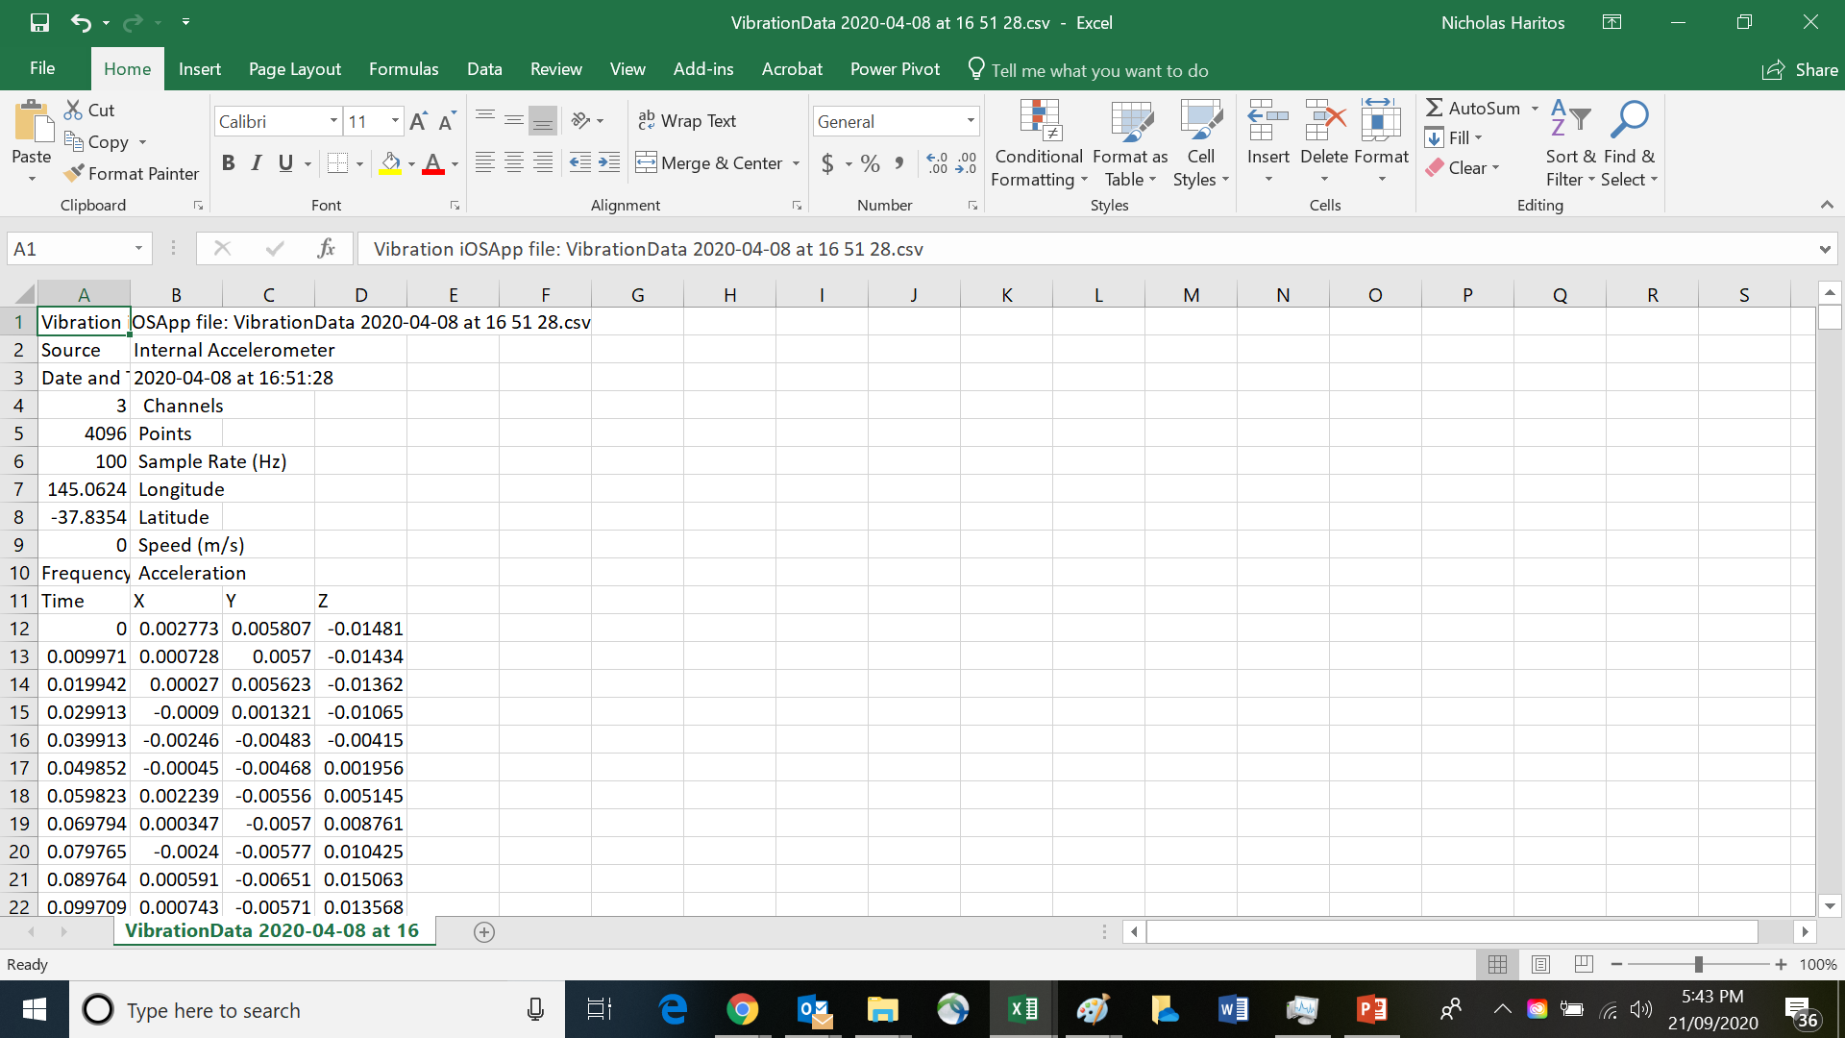
.CSV File “emailed” from Vibration App on iPhone 6
SDOF Approximation (2-storey Sway Frame)

Slide 12
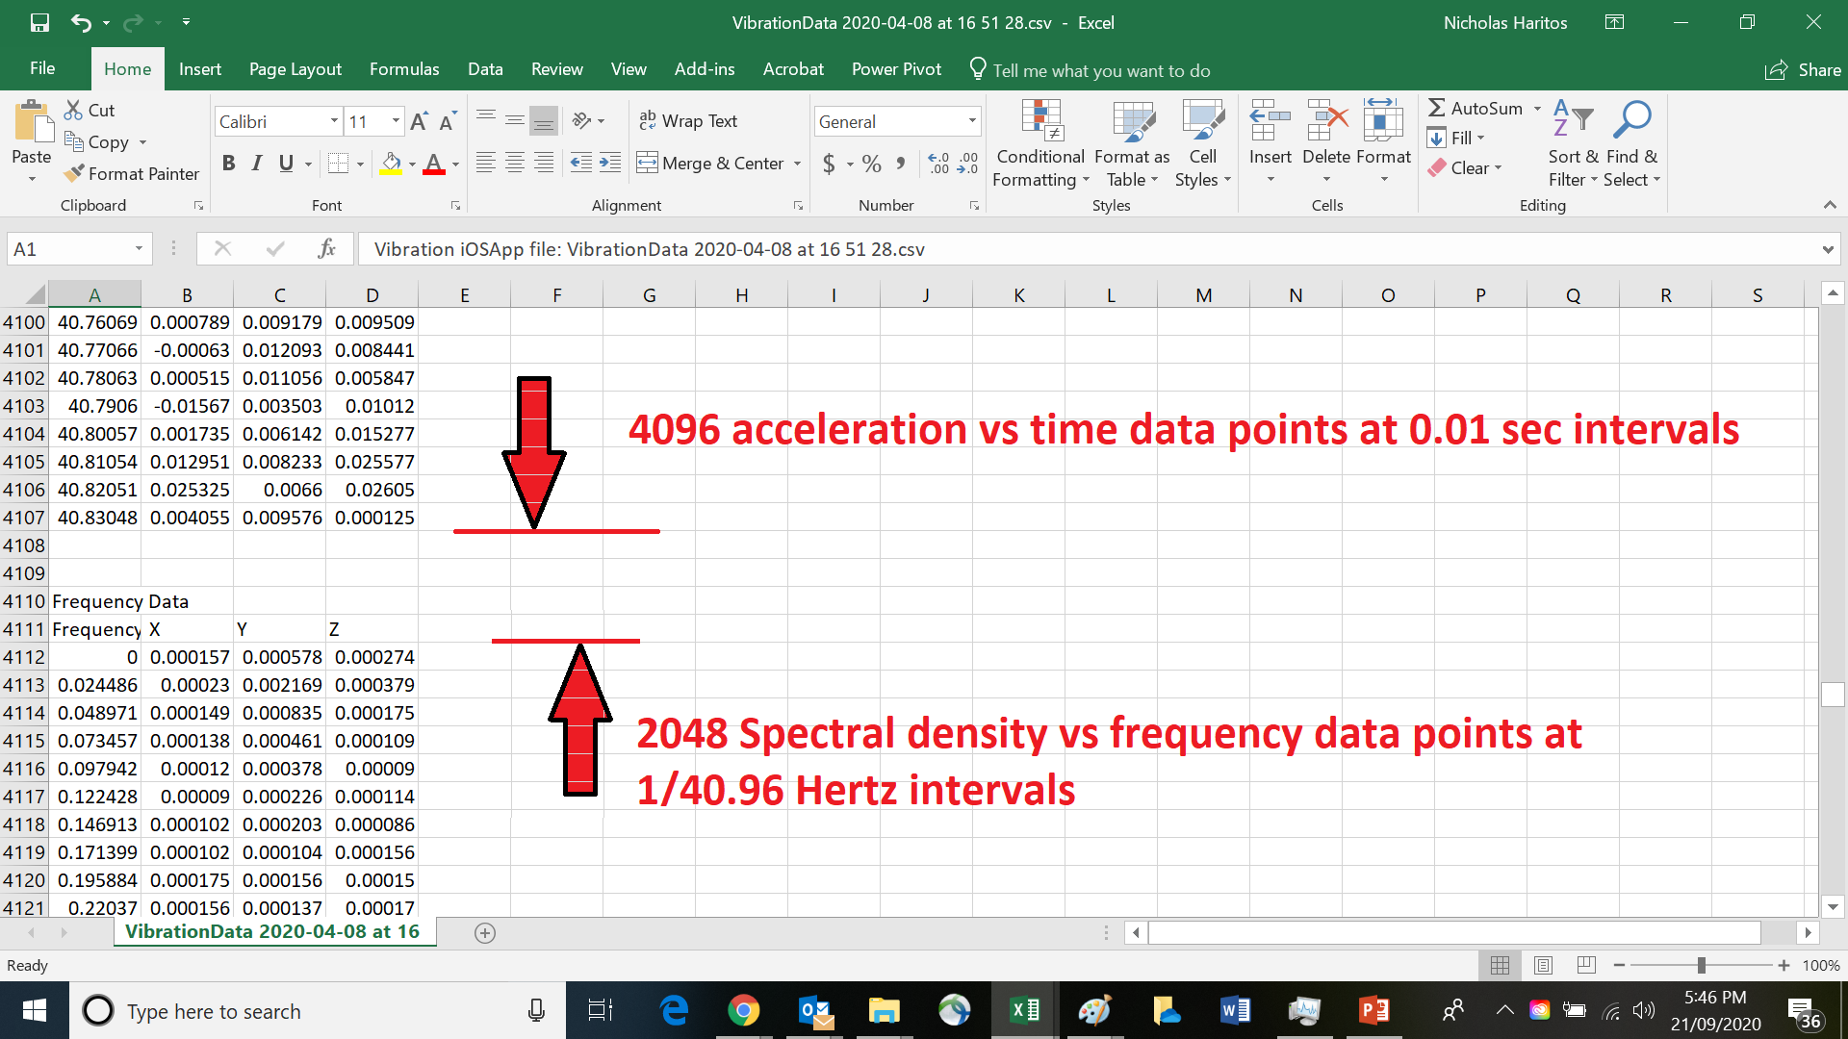
SDOF Approximation (2-storey Sway Frame)

Slide 13
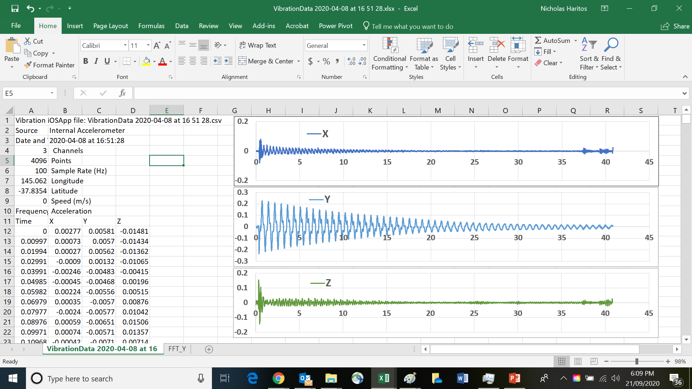
Convert .CSV file from Vibration App to .xlsx file & plot time domain data
small
vertical
It is clear that the horizontal (y) response dominates over the x & z
horizontal
“Ripple” ~gone
“Ripple”
small
out-of-plane
SDOF Approximation (2-storey Sway Frame)

Slide 14
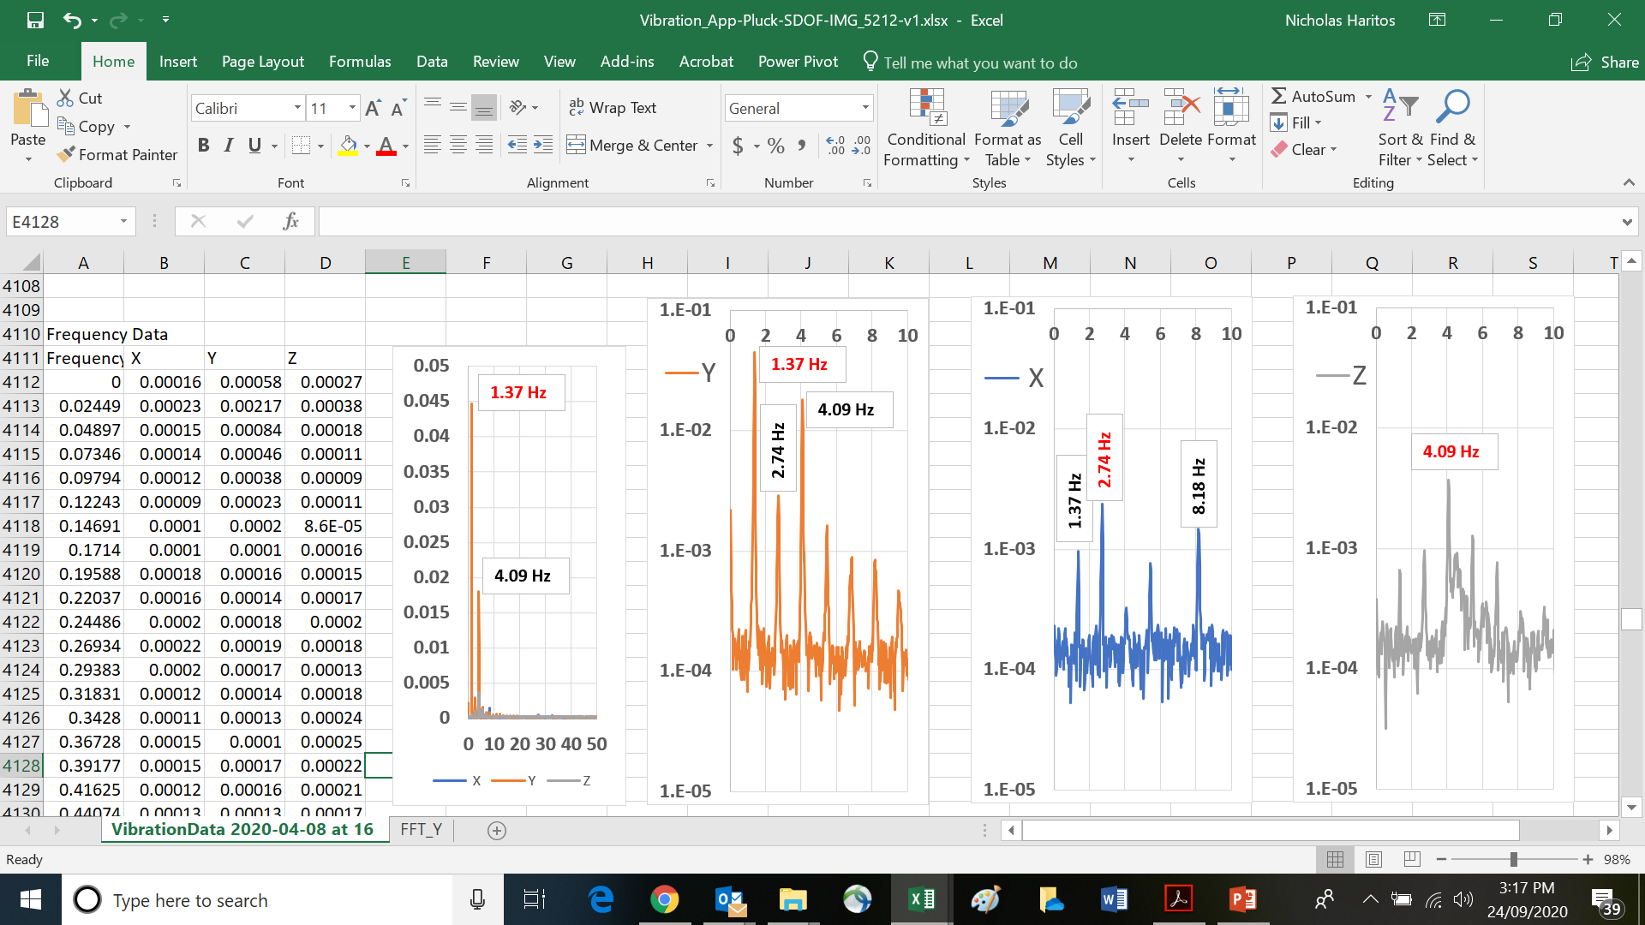
Convert .CSV file from Vibration App to .xlsx file & plot frequency domain data
It is clear that the horizontal (y) response possesses a dominant frequency component at 1.37Hz and a second dominant frequency component at 4.09Hz
Periodic response at integer multiples of 1.37 Hz
SDOF Approximation (2-storey Sway Frame)

Slide 15
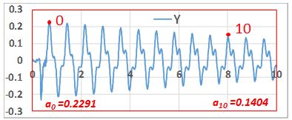
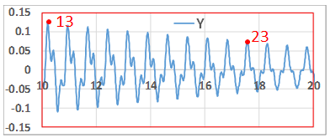
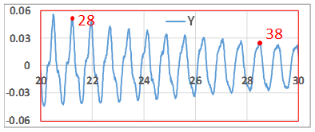
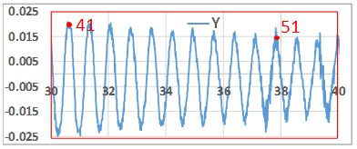
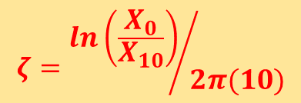



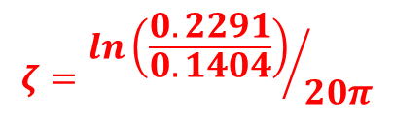
0
Natural Frequency
10
20
30
40
50
$$f_{n}=\frac{No of Cycles}{Time taken}$$
$$=\frac{50}{(37.11−0.71)}$$
t₅₀ = 37.112
t₀ = 0.708
${→f}_{n}$= 1.37 Hz
Damping estimate
First 10 secs of record
$$ζ={ln\left(\frac{X_{0}}{X_{10}}\right)}/{2π(10)}$$
$$ζ={ln\left(\frac{0.2291}{0.1404}\right)}/{20π}$$
$$ζ=\frac{0.4894}{20π}=0.78\%$$
SDOF Approximation (2-storey Sway Frame)

Slide 16
Concluding Remarks
An investigation was performed on the acceleration response data obtained using the Vibration App on an iPhone6 located on the top storey of a 2-storey sway frame model after displacing the top storey to one-side and releasing it from “at rest” – the condition of simple “pluck test”.
Analyses based upon a SDOF modelling assumption were used to:
Determine the natural frequency using the cycle counting method
Estimate the critical damping ratio over the first 10 seconds of the response
Observations made included:
The presence of a second major frequency of response (a response ripple) in the horizontal vibration of the 2-storey frame on the second storey
Other, smaller level responses at frequencies corresponding to integer multiples of the natural frequency were present in the horizontal vibratory response.
Simply Supported Bar

Slide 17

There are many more experiments and their results that are progressively being added to the four thematic Modules in www.Mechanics-Lab.com that are available for access to subscribing institutions.
Please subscribe so that we can continue to progress the rate, range and extent of this valuable repository of experiments that supports the teaching & learning of fundamental engineering concepts and beyond.
Link to Subscription Page

